Slide 1
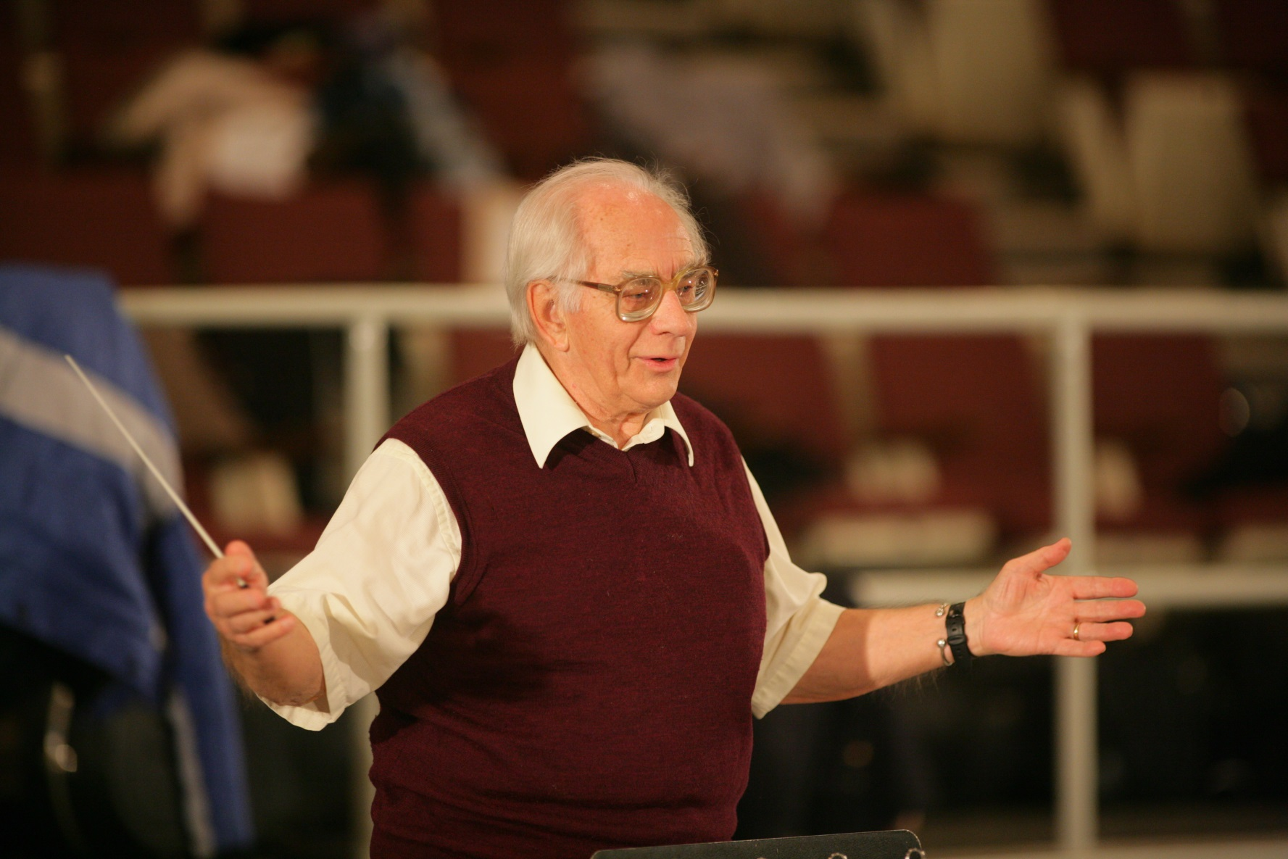
Honouring Don McKellar

Slide 2
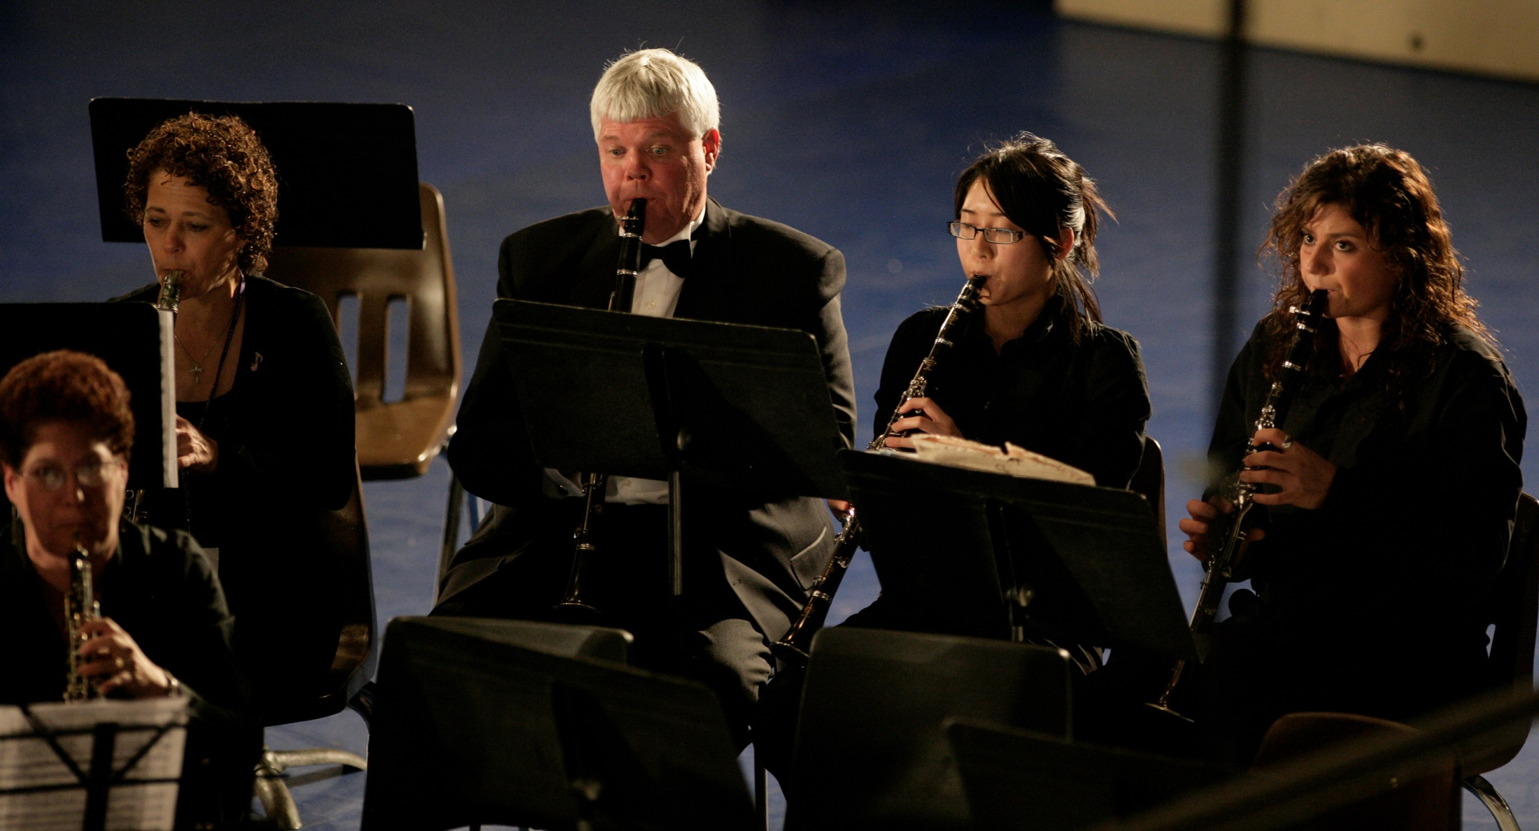

Slide 3
Professor Don,
Thank you for all the leadership, driving force and kindness you have displayed in your efforts to create a vibrant, thriving and world-class Faculty of Music at Western University. From humble (but very special) beginnings at the Silverwood Building to the musical forte the Faculty is today, much of that credit belongs to you.
On a personal note, I have always appreciated Wesanne's piano tutelage, and your continued and thoughtful interest in my life.
Enjoy the day!
Margaret Van Camp (Dirstein)
B. Mus 1970

Slide 4
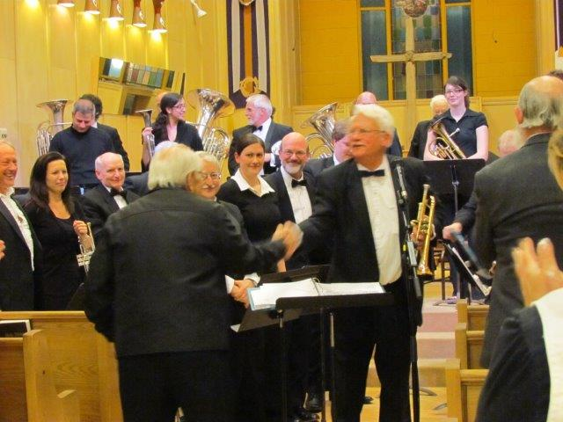

Slide 5
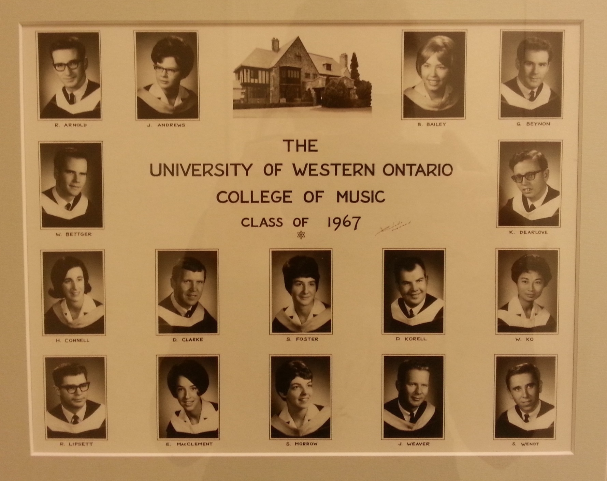

Slide 6
Dear Don,
I am so pleased that you are being honoured today! I remember very well how much time and effort you put into helping each new group of Western music students learn what it means to think and act professionally. During the time that I was a student at Western, you continually encouraged the female students to excel and that was almost unheard of in society at that time! I took your many offerings of advice very seriously and they have had a great impact on my life. And it never really ends because I know that I, like many others, will always hear your voice in my ear.
Your energy and passion for music and music education have made the world a better place for countless students during your years at Western. And many of us have been blessed with your friendship as well.
Thank you, Don!
Nancy Telfer

Slide 7
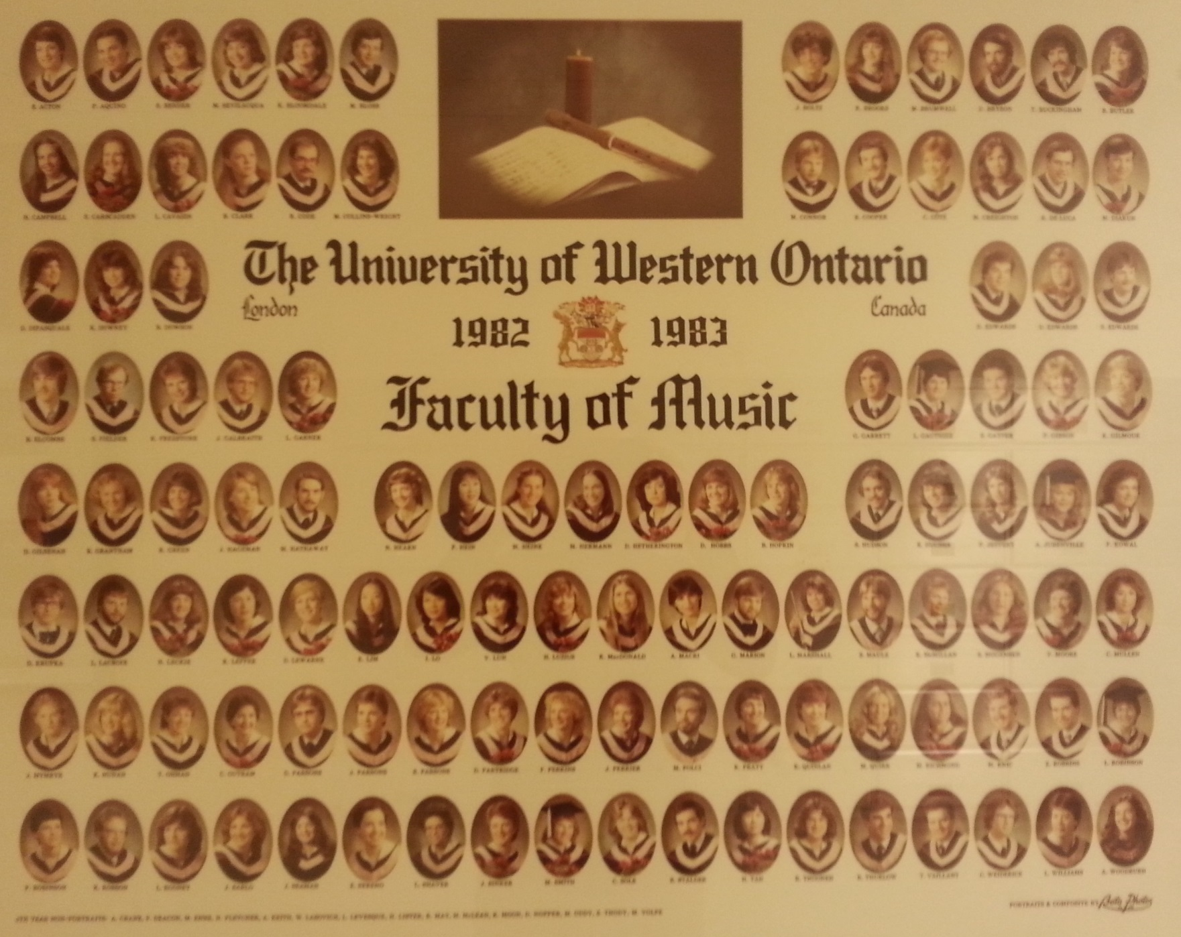

Slide 8
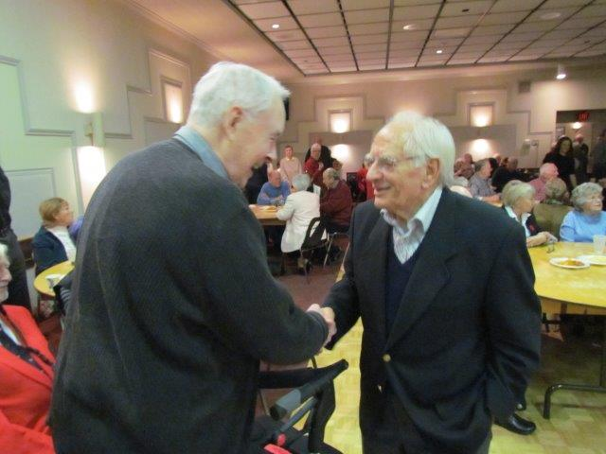

Slide 9
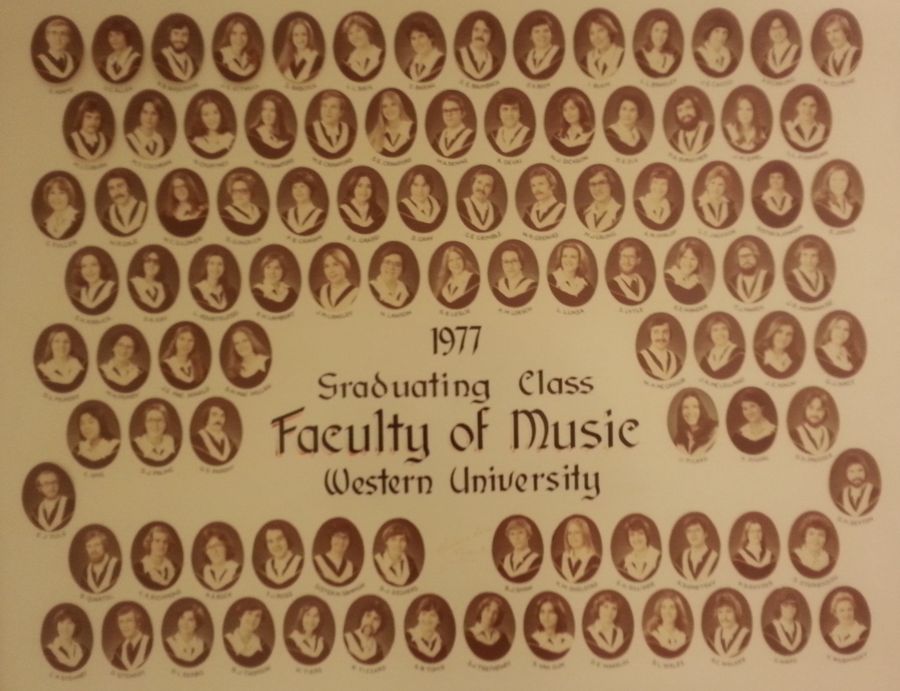

Slide 10
I remember Mr. McKellar stopping me in the hall on the way to the cafeteria (Silverwood Building) at the beginning of third year and letting me know that year 2 wasn’t as successful as it could have been - my average was about 8% lower than it had been in first year ... after that wee “chat” (I didn’t even think that he knew who I was) it was raised by 9% at the end of year 3. Talk about the motivation of being stopped by McKellar!!!
Corinne MacDonald ,72

Slide 11
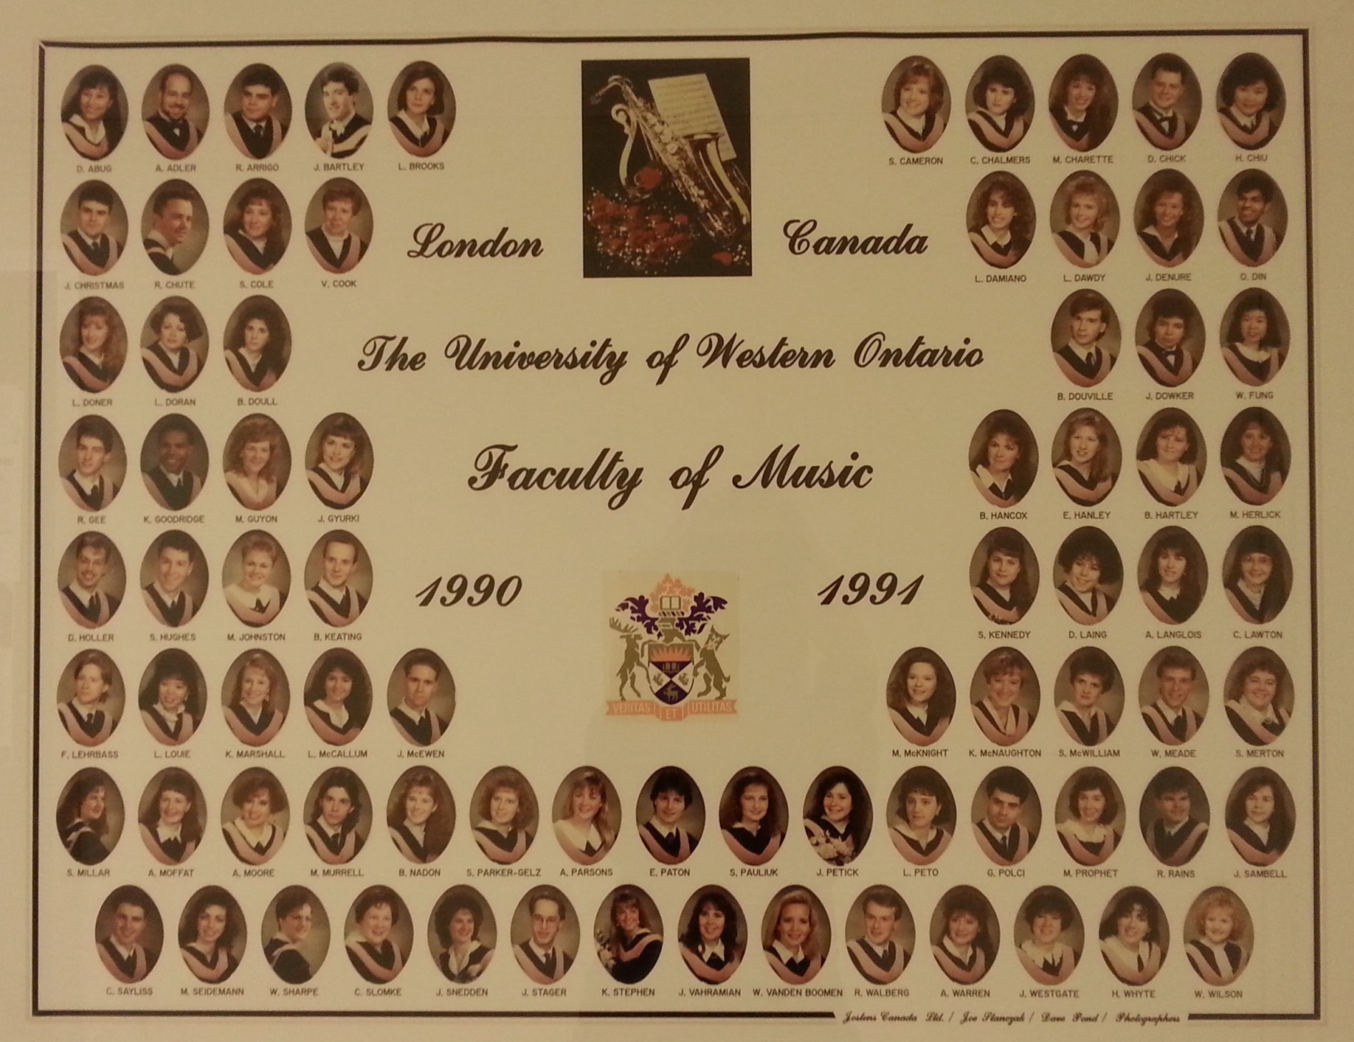

Slide 12
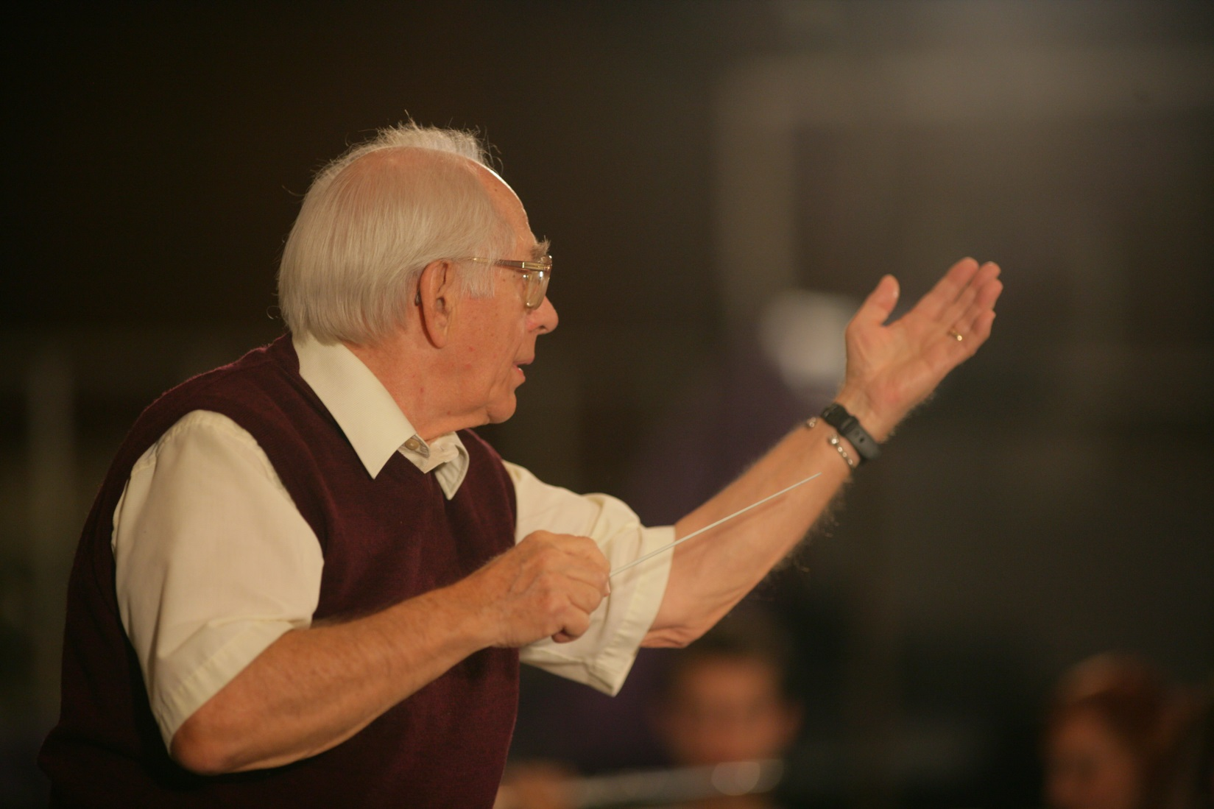

Slide 13
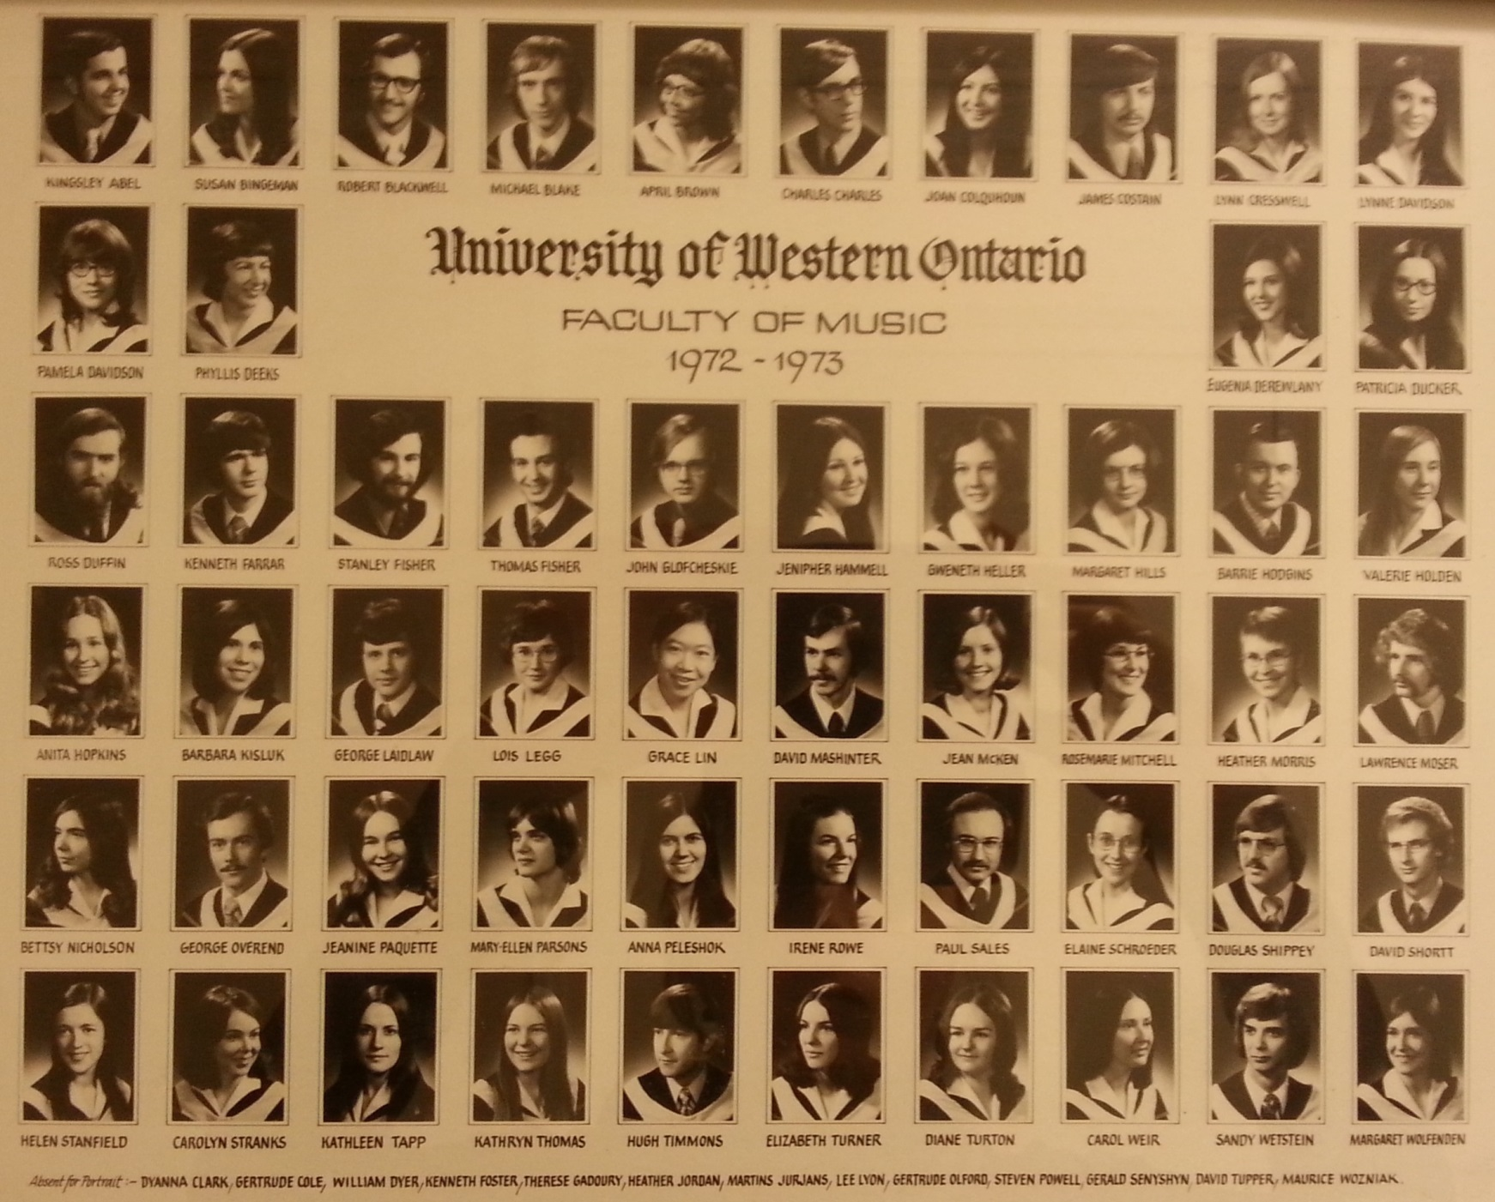

Slide 14
Please pass on my absolute best to Don. We have a neat connection – not only did he teach me when I was studying music at Western, he also taught my mother Phyllis Short music at Nepean high school in Ottawa back in the 50s. His contributions to music are significant and very much appreciated. Thank you Don!
Best,
Angie Simo Brown

Slide 15
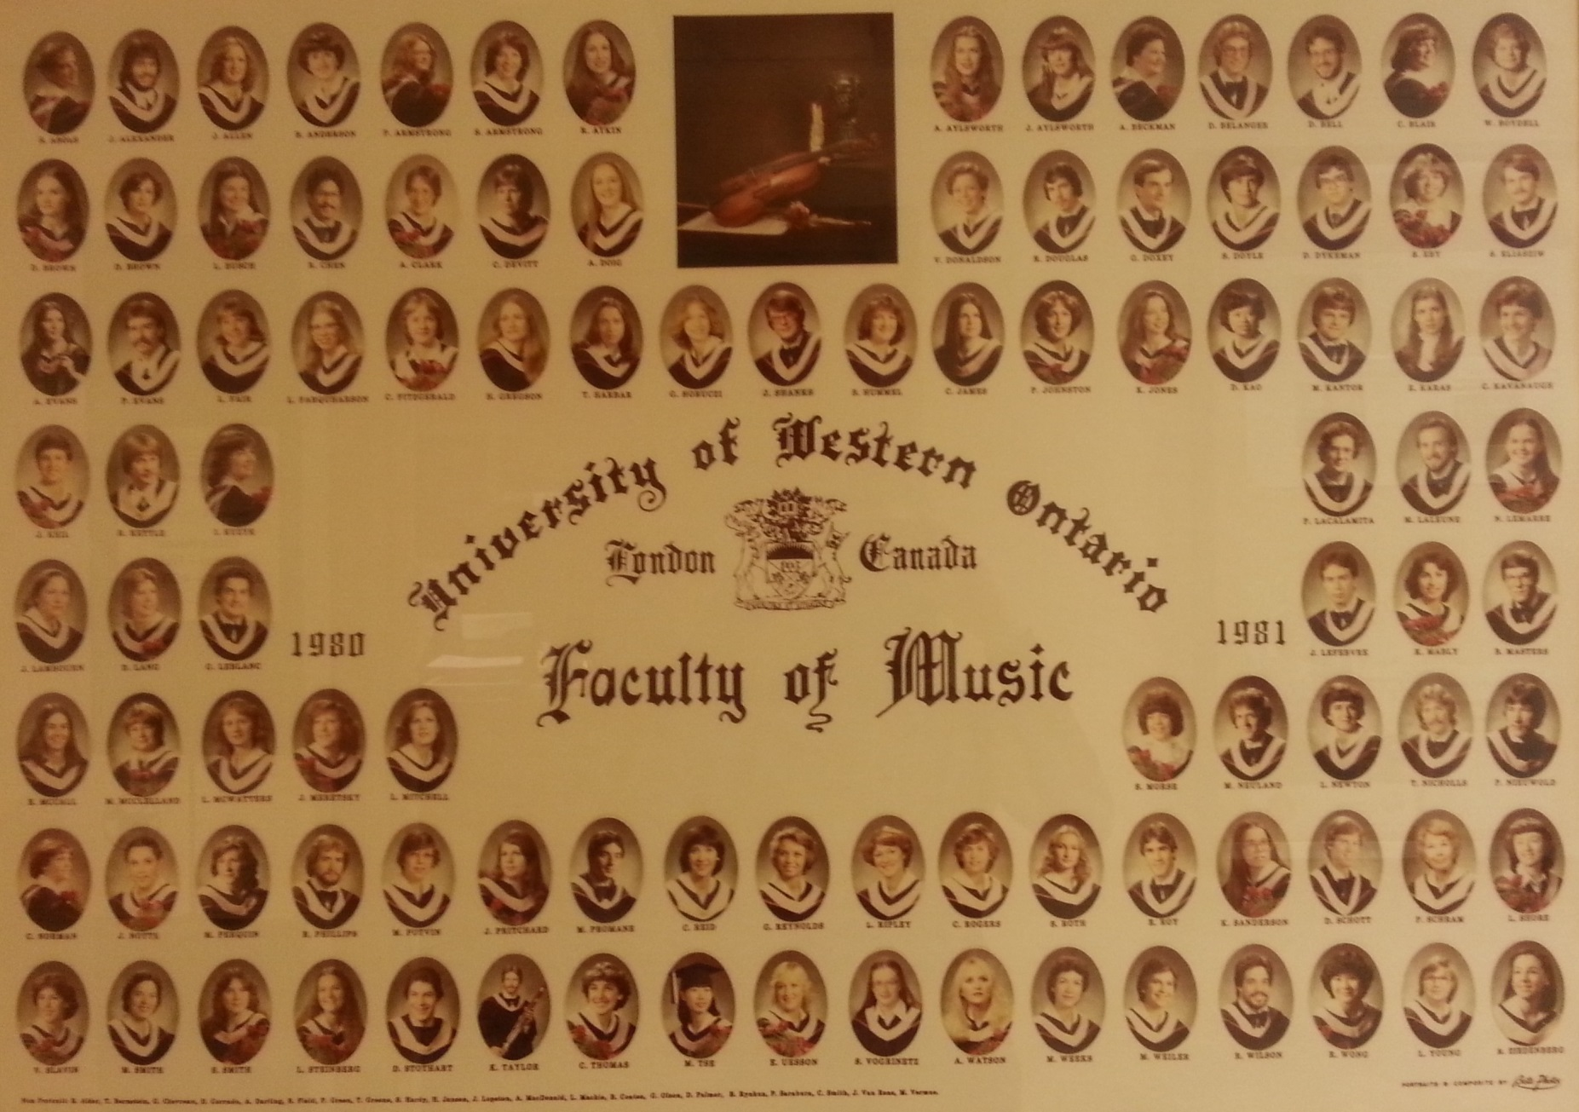

Slide 16
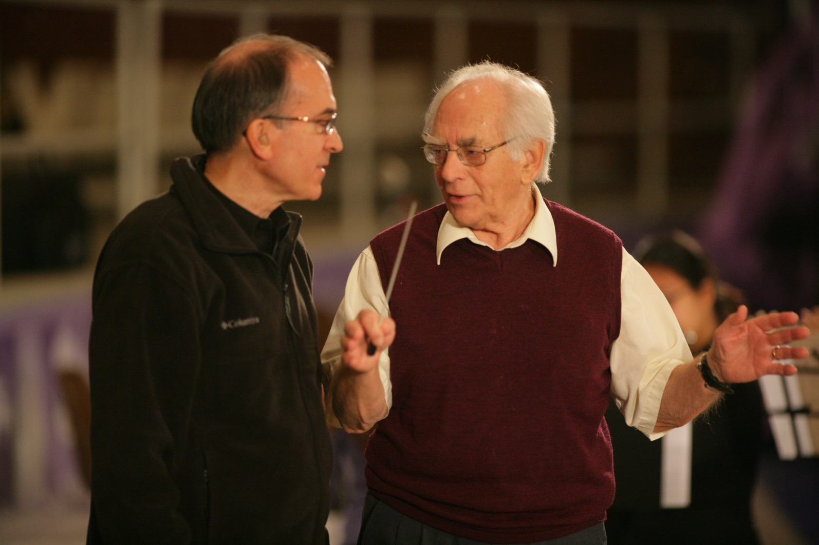

Slide 17
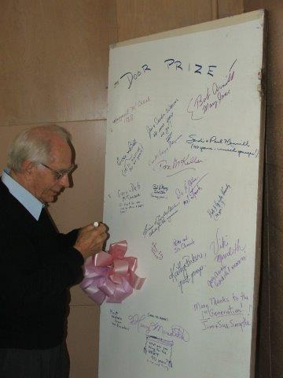

Slide 18
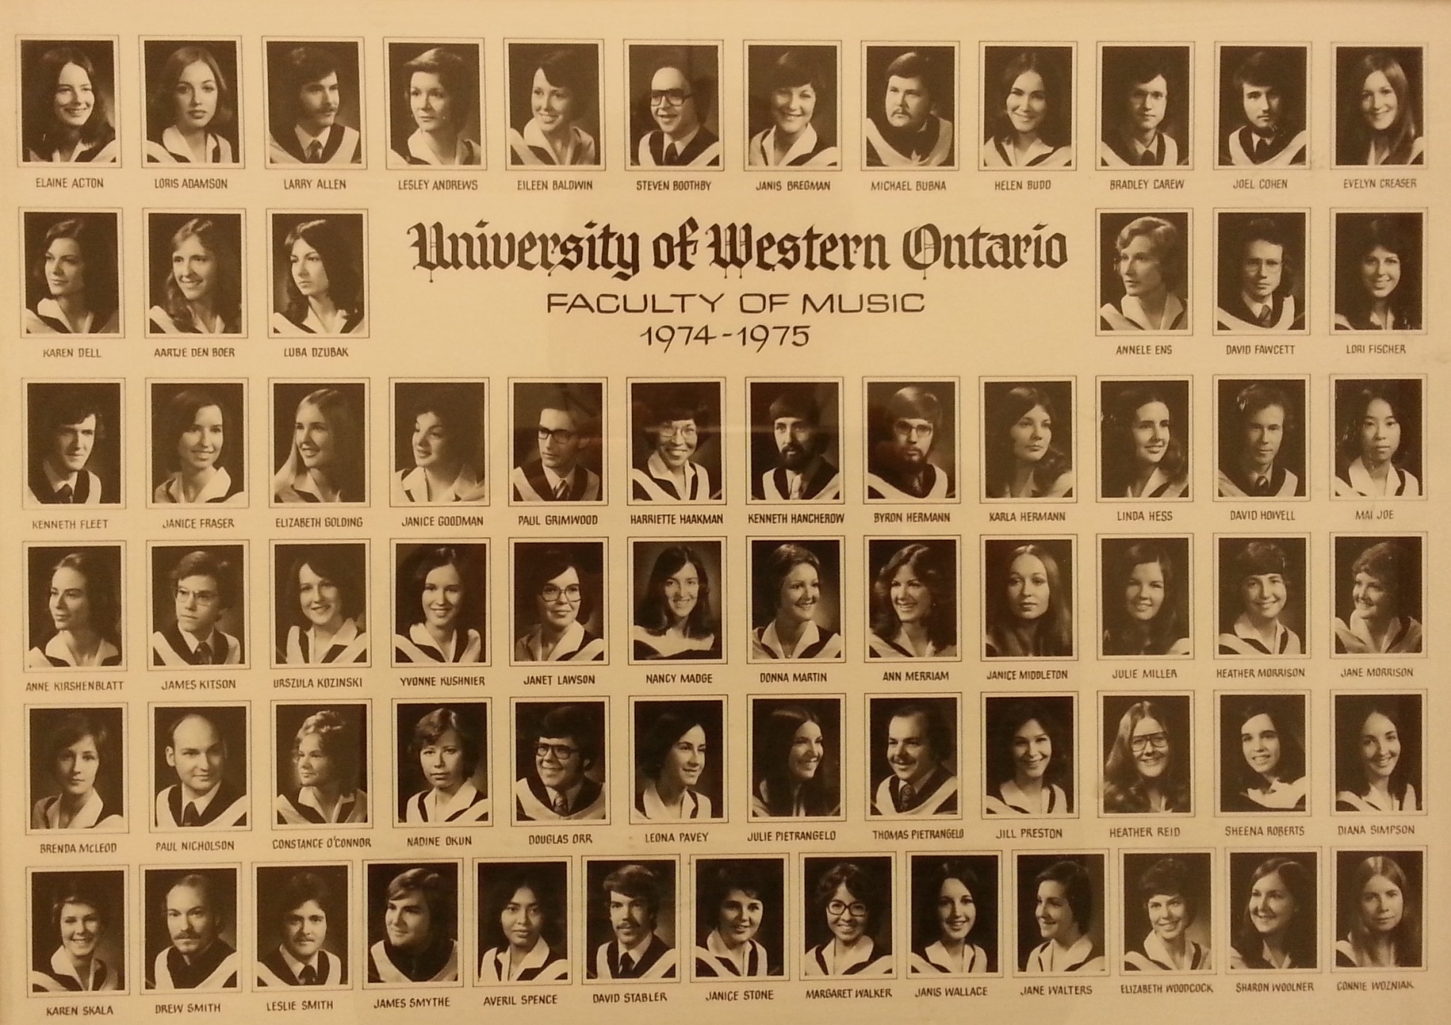

Slide 19
Best regards to Professor McKellar! He put a lot of effort into making sure that we were well trained as teachers.
Sue Willson, class of 74
I am elated that Don is being recognized and valued for his wonderful contributions to Westerns music and the lives of so many students and musicians. I am honoured to attend this beautiful event!!
Sharon Loucks

Slide 20
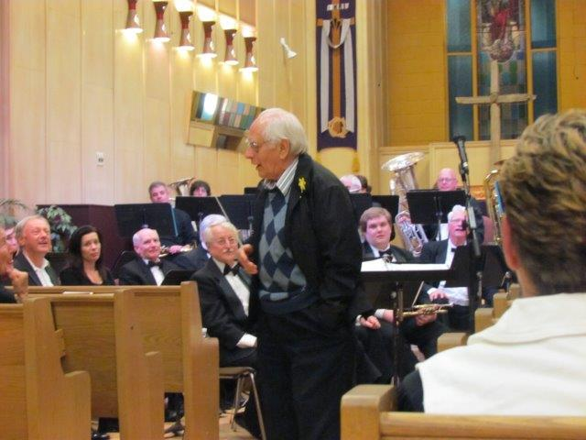

Slide 21
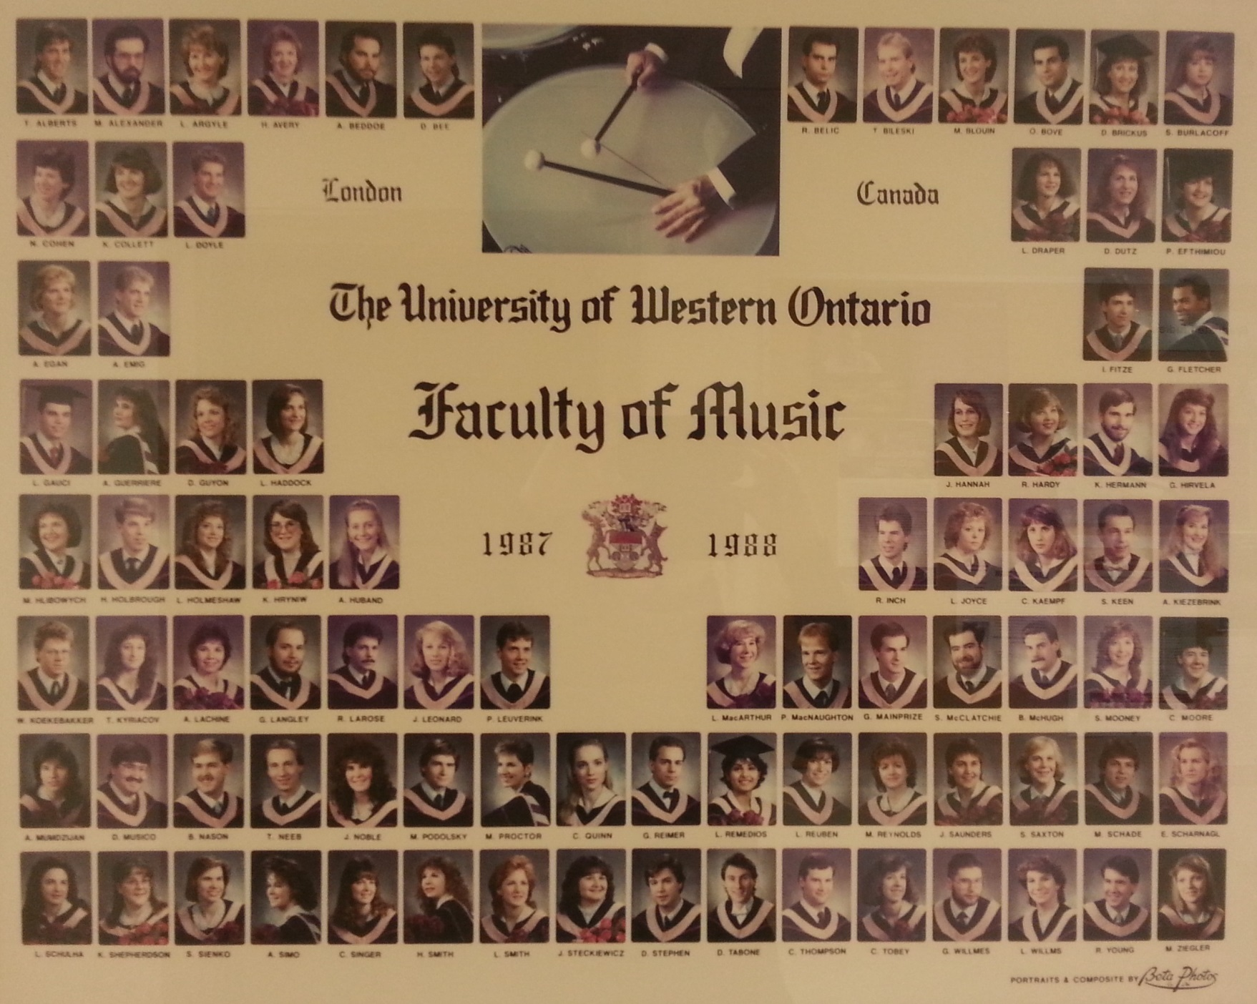

Slide 22
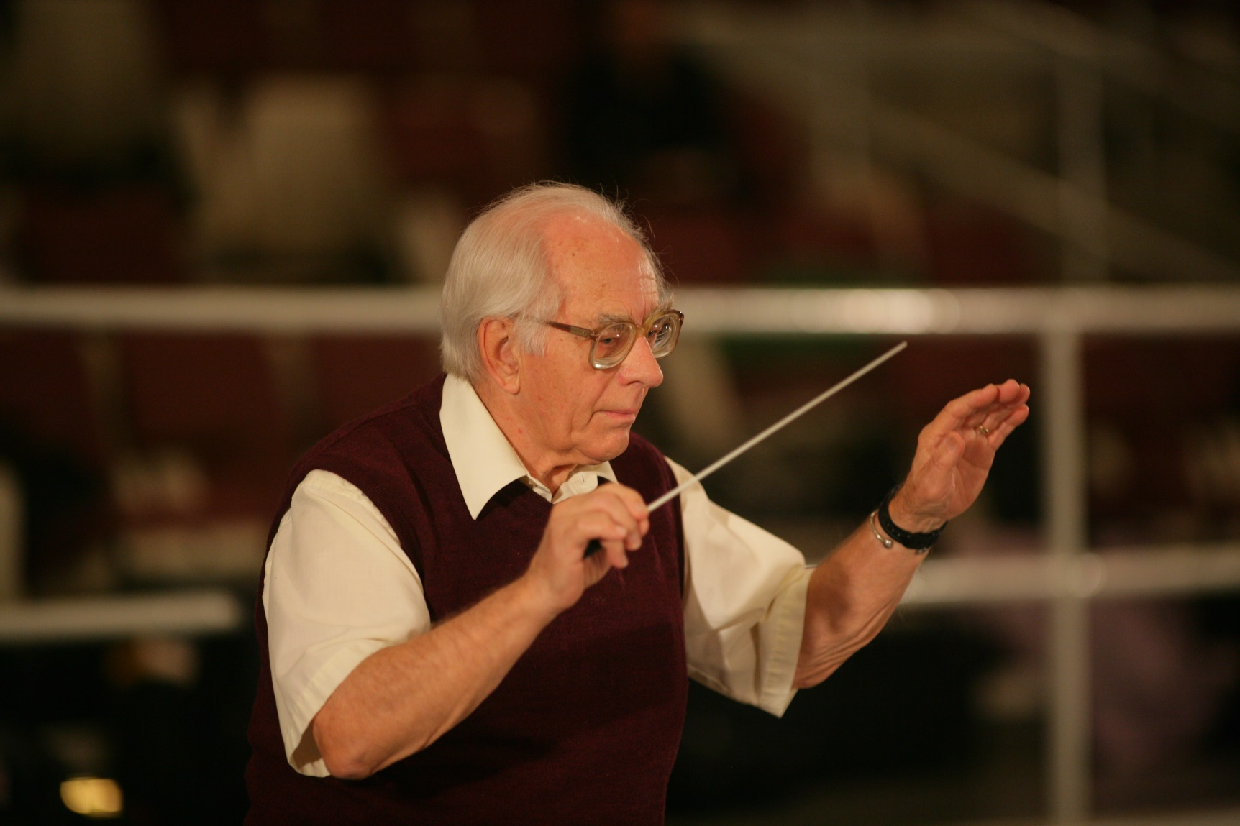

Slide 23
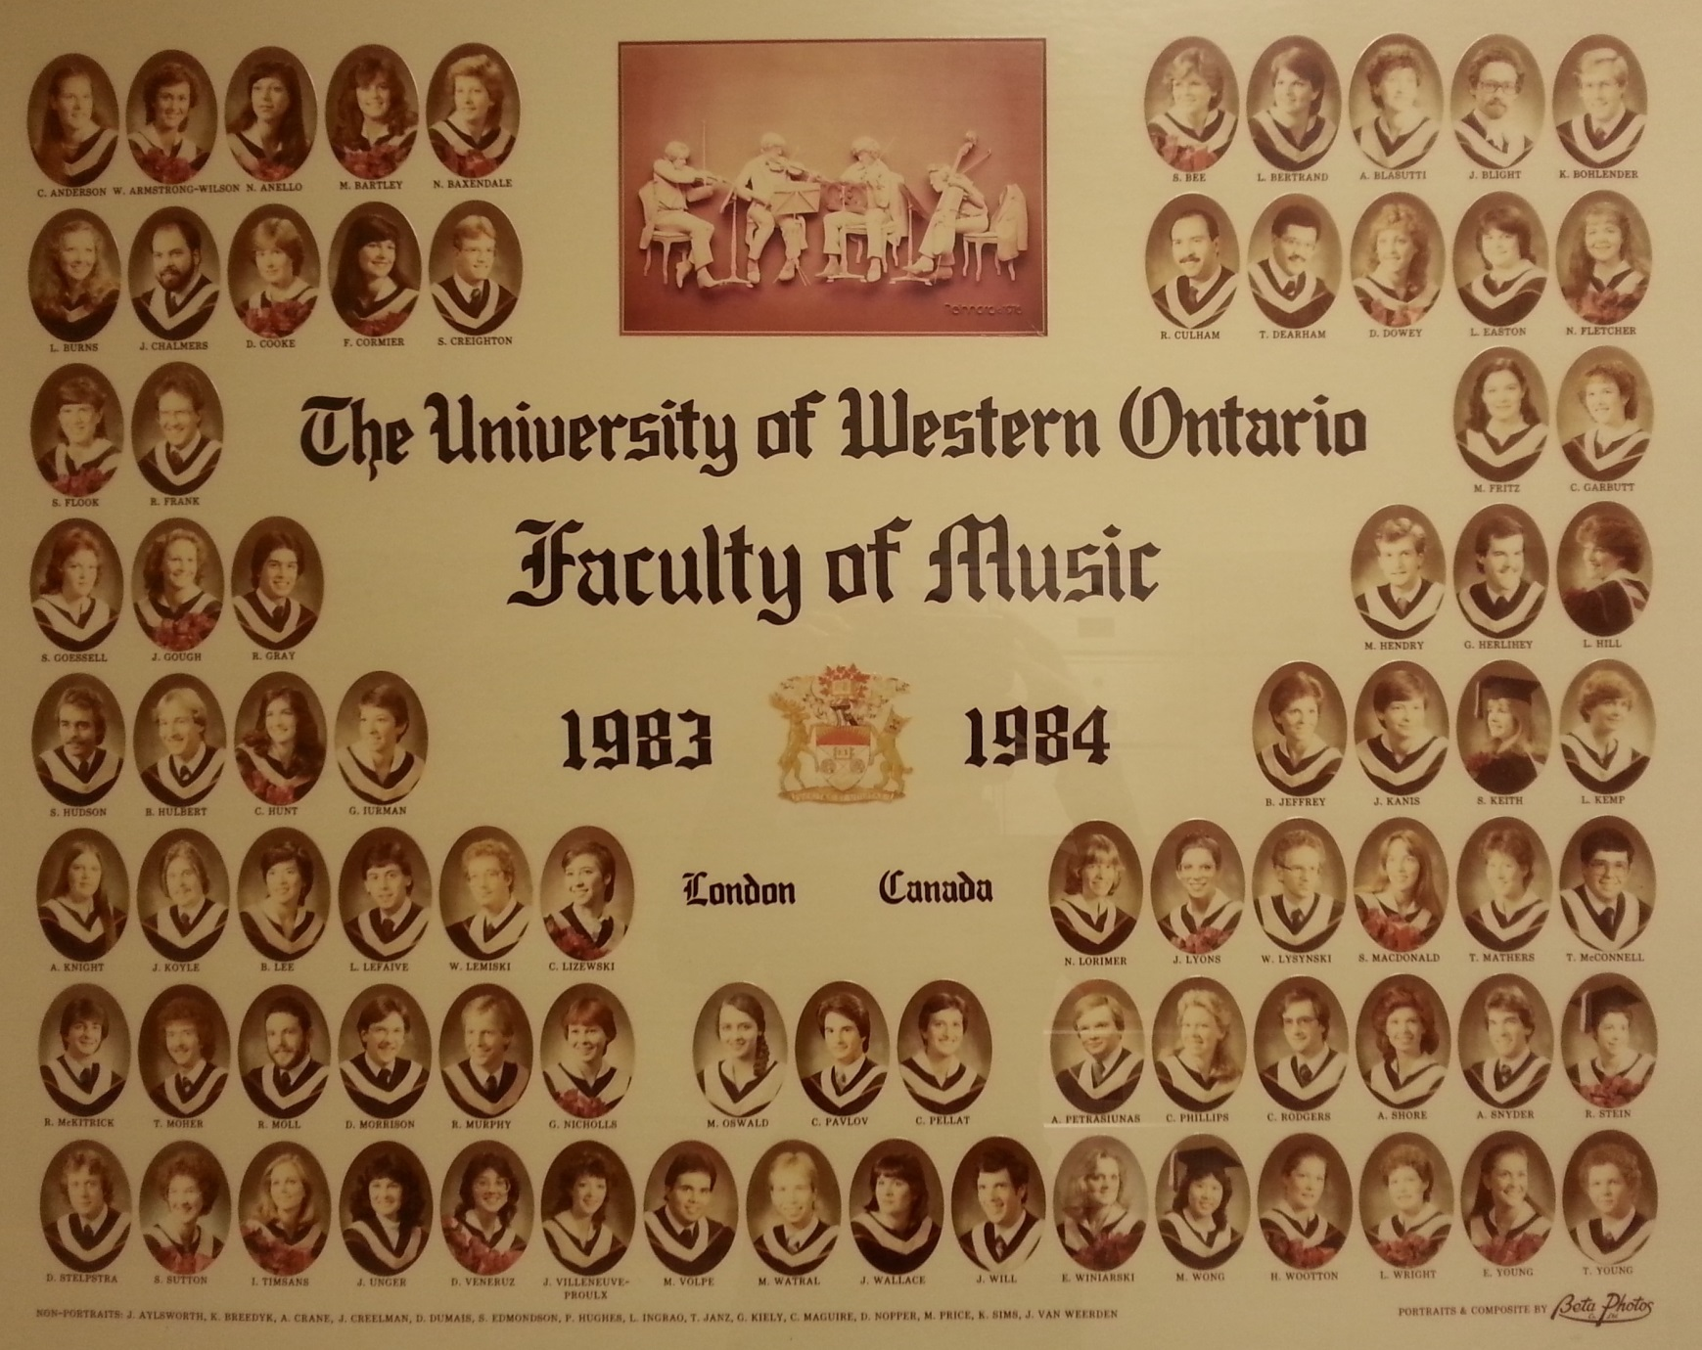

Slide 24
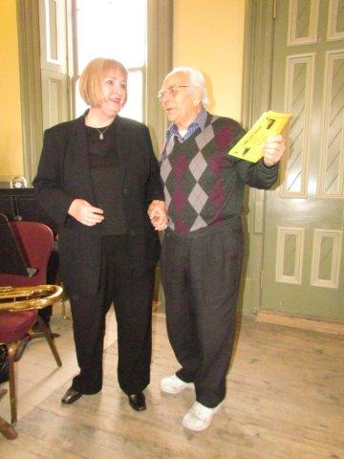

Slide 25
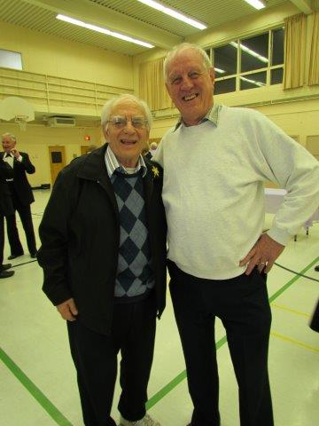

Slide 26
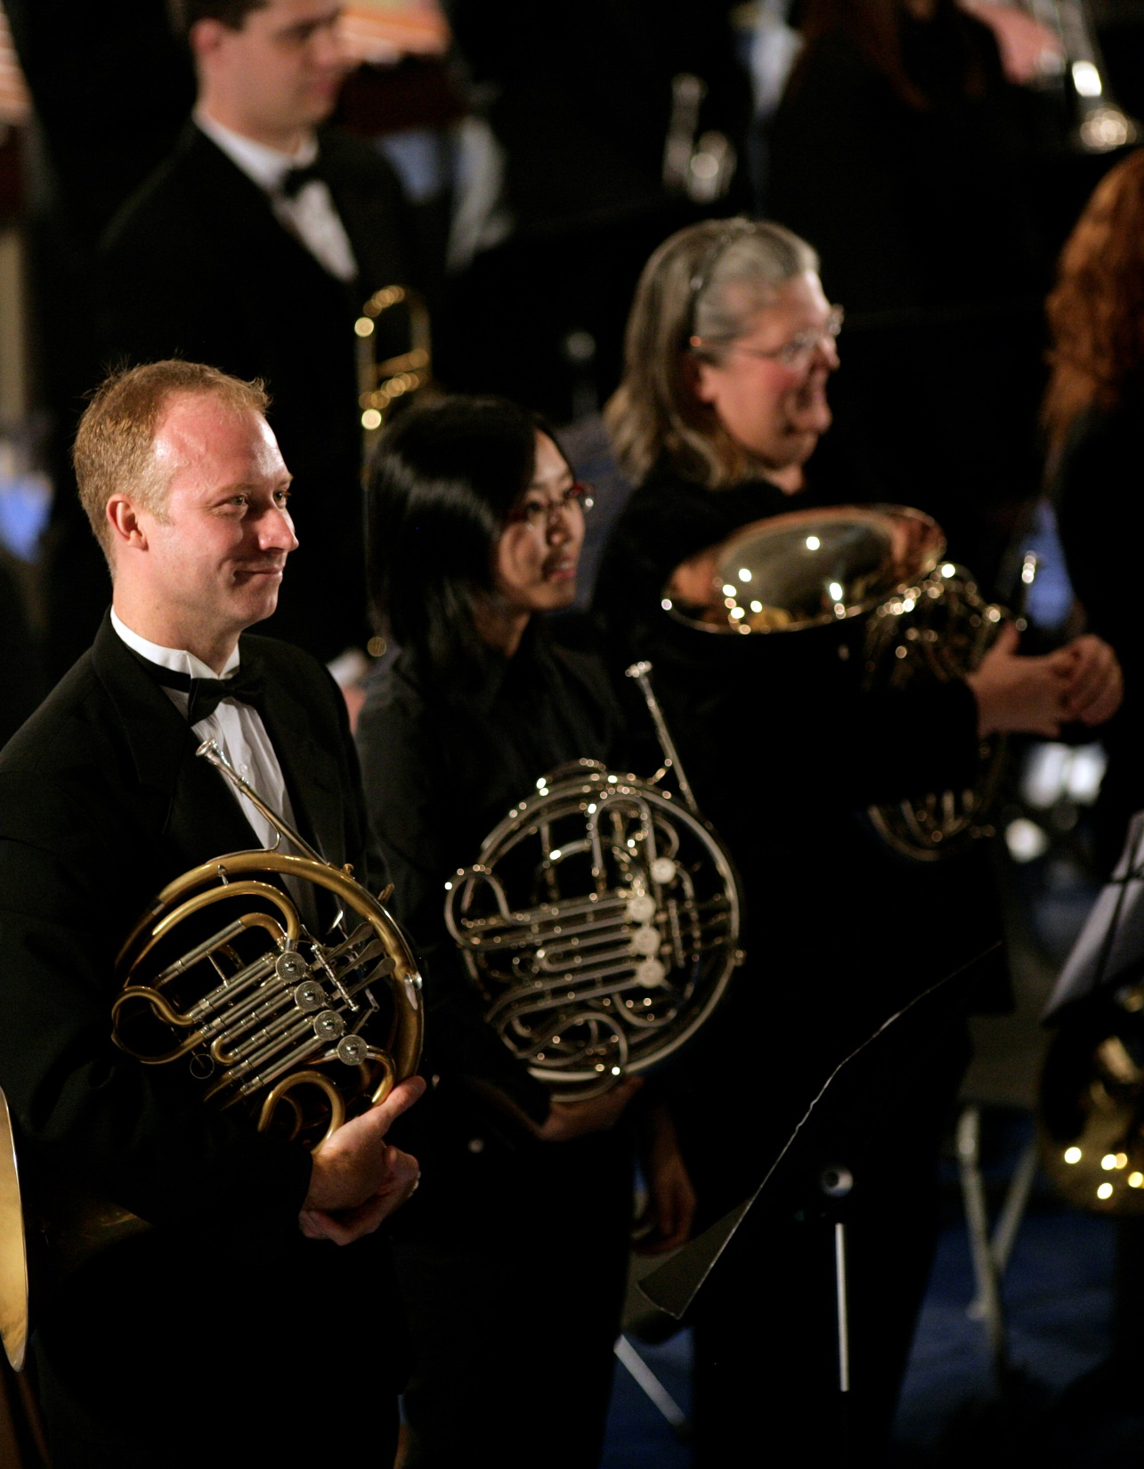

Slide 27
My most exuberant congratulations to a man most deserving of such an honour. Don helped me and all who attended the music faculty during his tenure there to carve out our future. For that I am eternally grateful. Congratulations, again, Don, and may you continue to enjoy many more years of doing what you do with unending passion.
Respectfully,
Dave Elston; class of '72

Slide 28
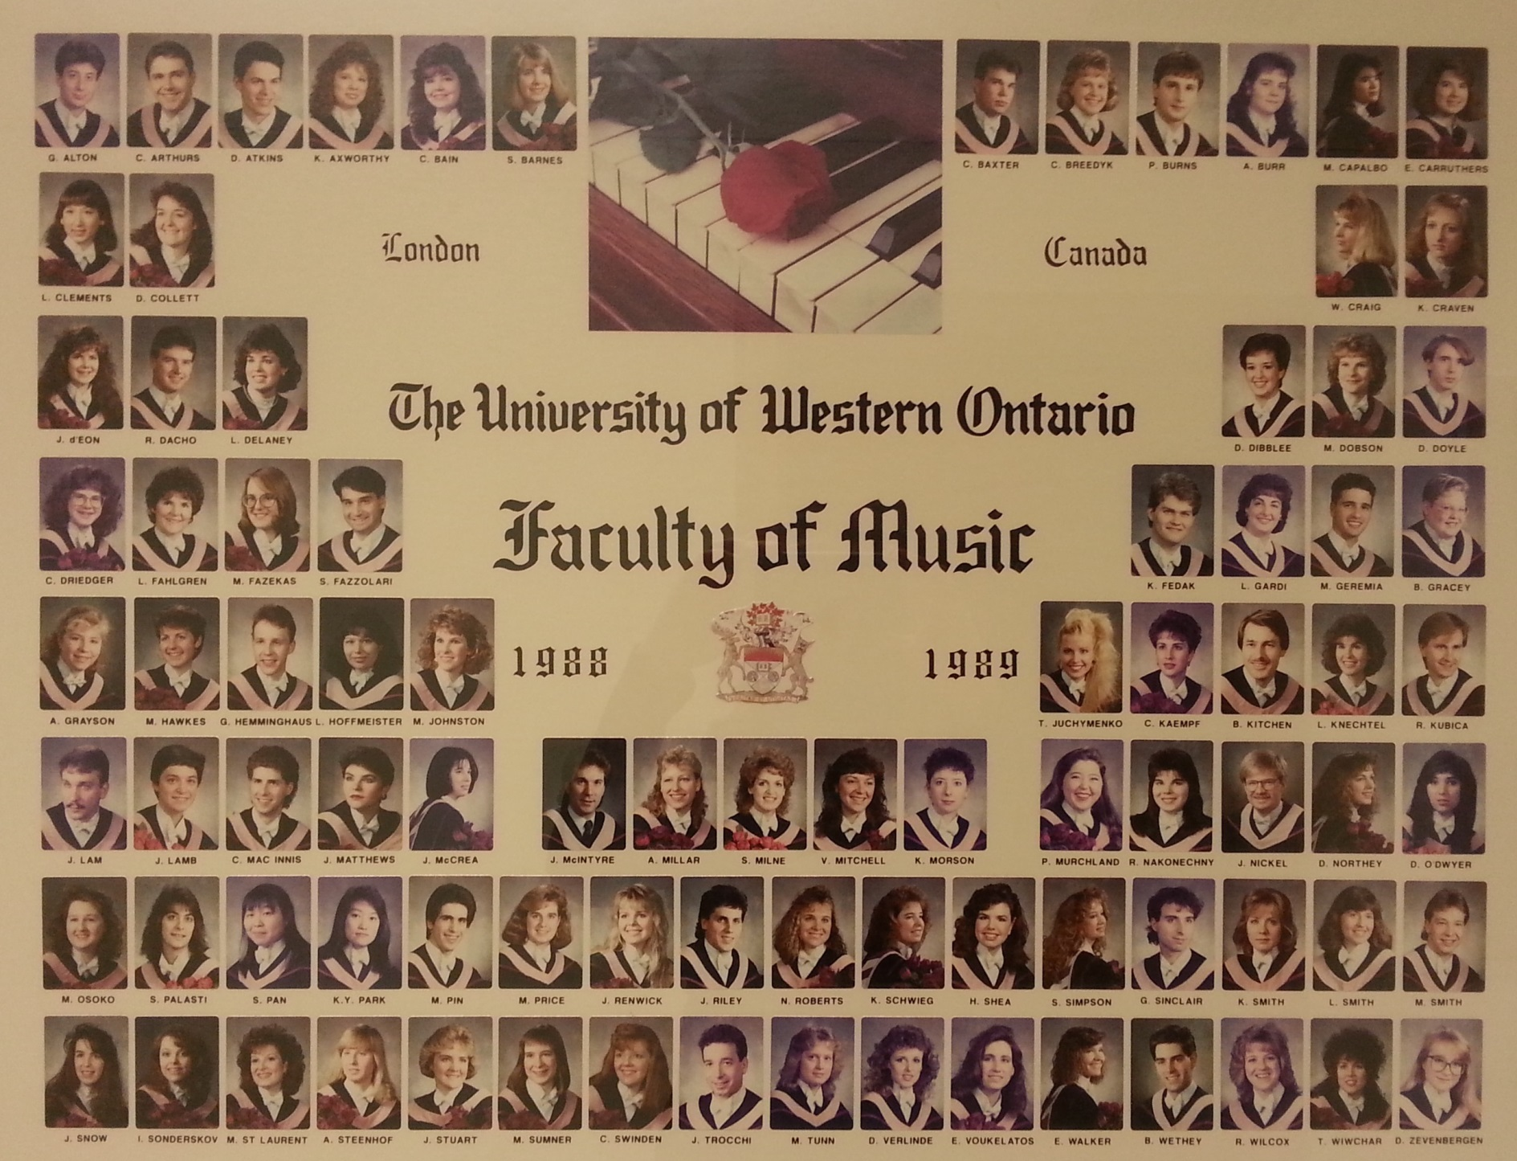

Slide 29
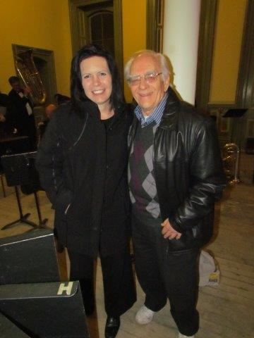

Slide 30
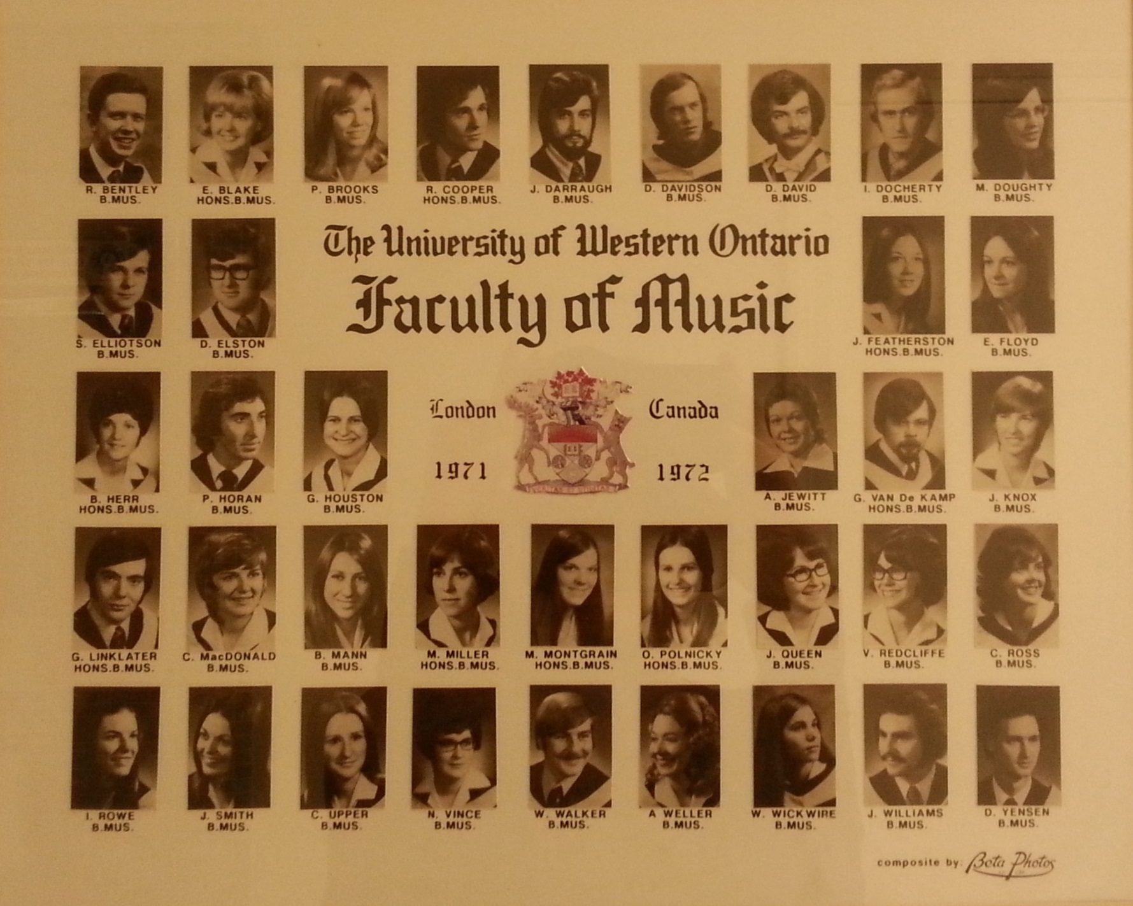

Slide 31
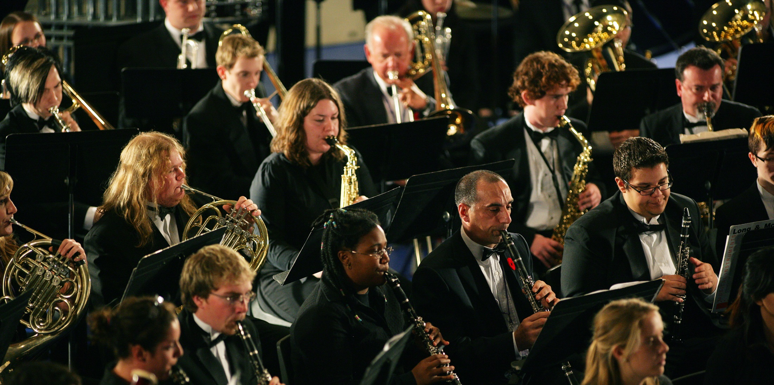

Slide 32
I have great respect for Don and I have really appreciated the support he has given to me during my career. Please give him a hug for me!!
Linda Wharton
I remember Don McKellar so well as a professor and have we have crossed paths through the years. My best wishes are extended to Don!
Margaret Motum (Newton)
B. Mus 79
I remember Don McKellar very well and appreciate all he did for the Faculty of Music and for me. Please give him my best wishes.
Joan Colquhoun McGorman
B.A. Honours Music (cello) 1973

Slide 33
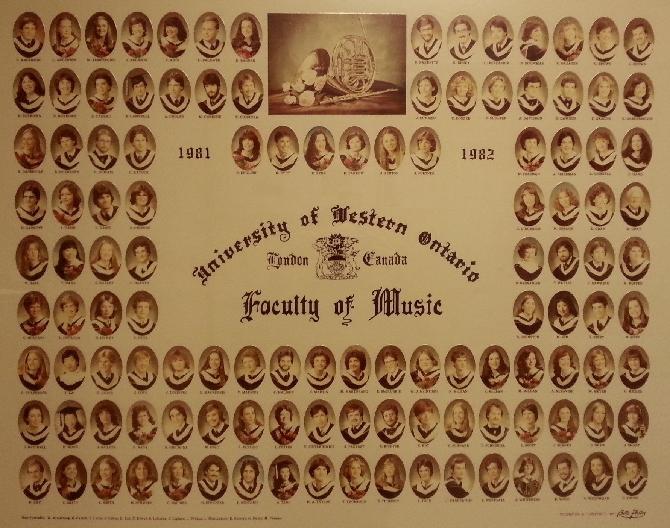

Slide 34
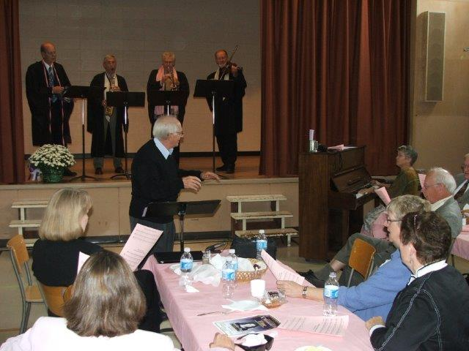

Slide 35
Don, Cindy and I are with you in spirit from Yellowknife and are very happy to hear about this tribute event. We would love to be there but can at least wish you much happiness and renewed friendships on this day at Carol and Gwynn's home. Thanks for the music education opportunities you brought to so many of us. Rest assured most of us are still at it in communities all over the map decades later.
Bill and Cindy Gilday

Slide 36
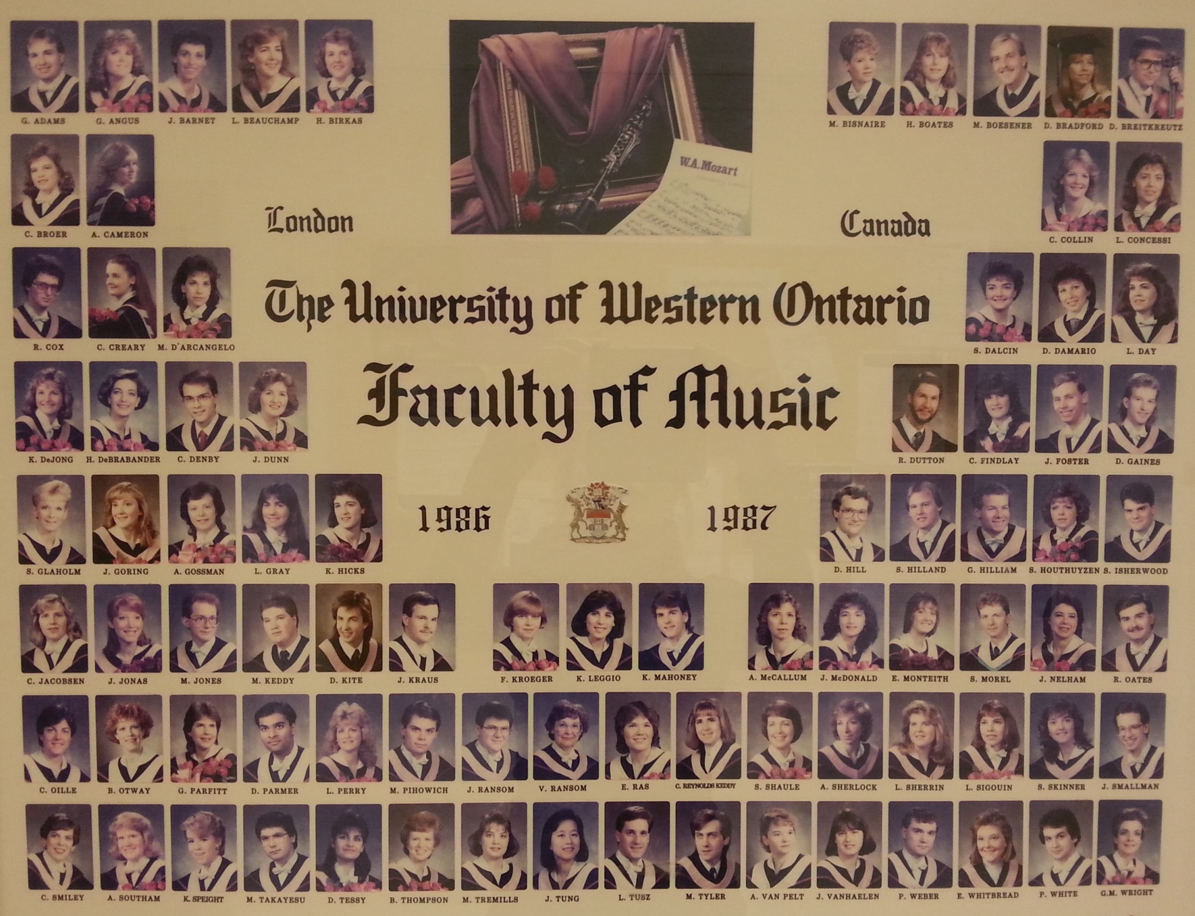

Slide 37
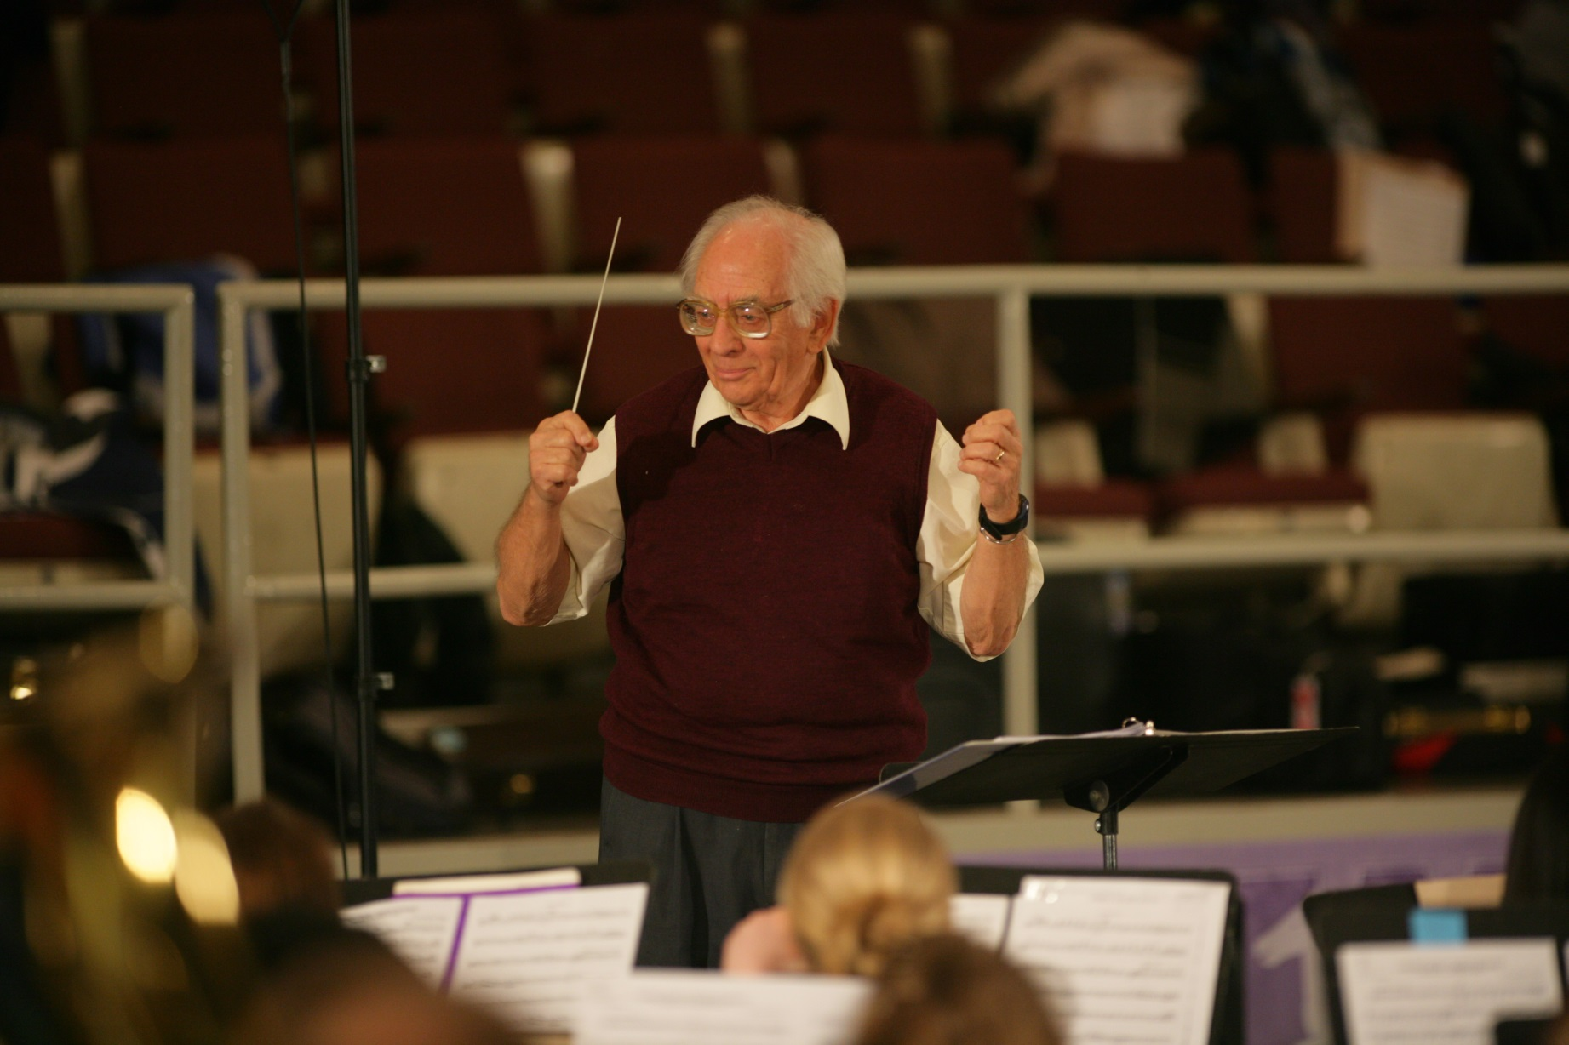

Slide 38
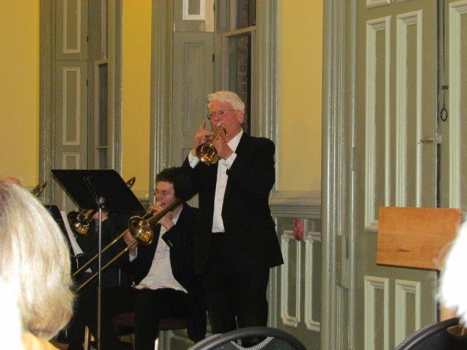

Slide 39
I feel fortunate to have selected UWO, (now Western U.) for its excellent music education program and dedicated professors like Don, as it prepared me well for a 30 years (and still going!) career as a music educator in the OCDSB. My bands and choirs have performed at the Chateau Laurier, at Parliament Hill, senior’s residences all over Ottawa, and music festivals. Some of my students are studying their instrument, composition or education at the post-secondary level, and living a rich, creative life. I feel so blessed and deeply satisfied to be part of the music education community!
Best wishes for a wonderful day of celebrating!
Cathy (Outram) Wilcox

Slide 40
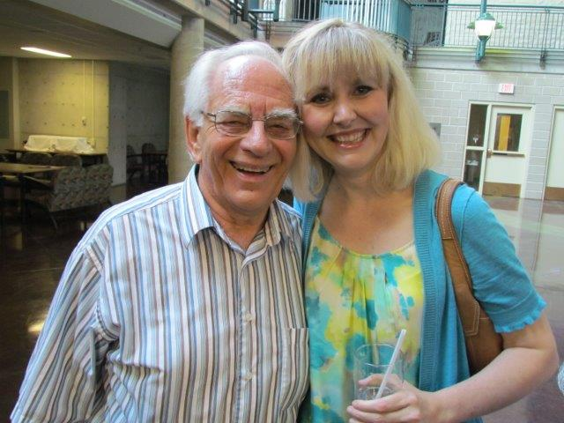

Slide 41
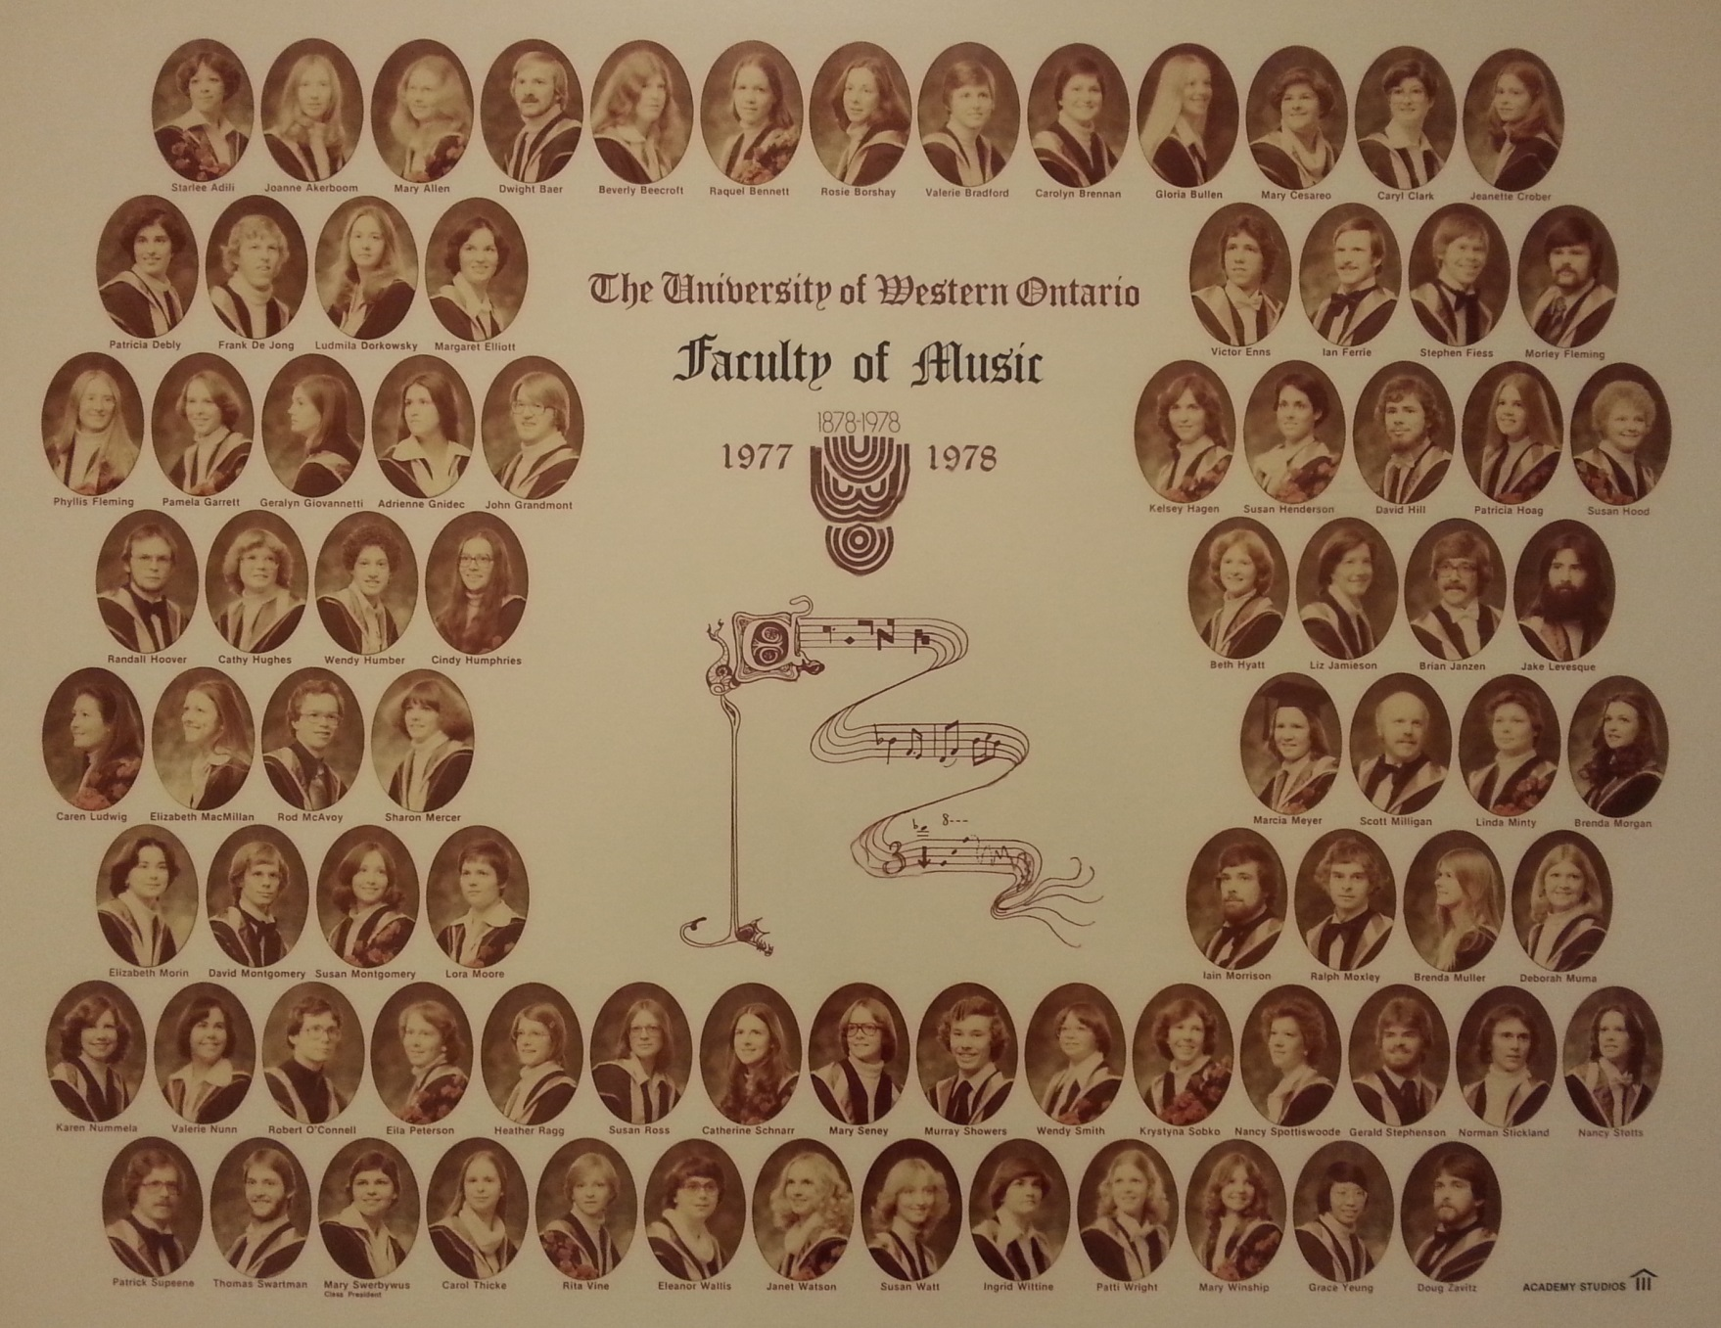

Slide 42
Professor Don McKellar was a favorite of mine and I will always remember his invitational type of teaching...he also has a grand sense of humour which helped us all as we were learning our instruments
at The College of Music Silverwood Building back in 1962...
Please let him know how much he is/was appreciated with the above qualities as a Professor when the learning curve varied for young music students at The College of Music.
Warmly, Mary Ellen Forsyth

Slide 43
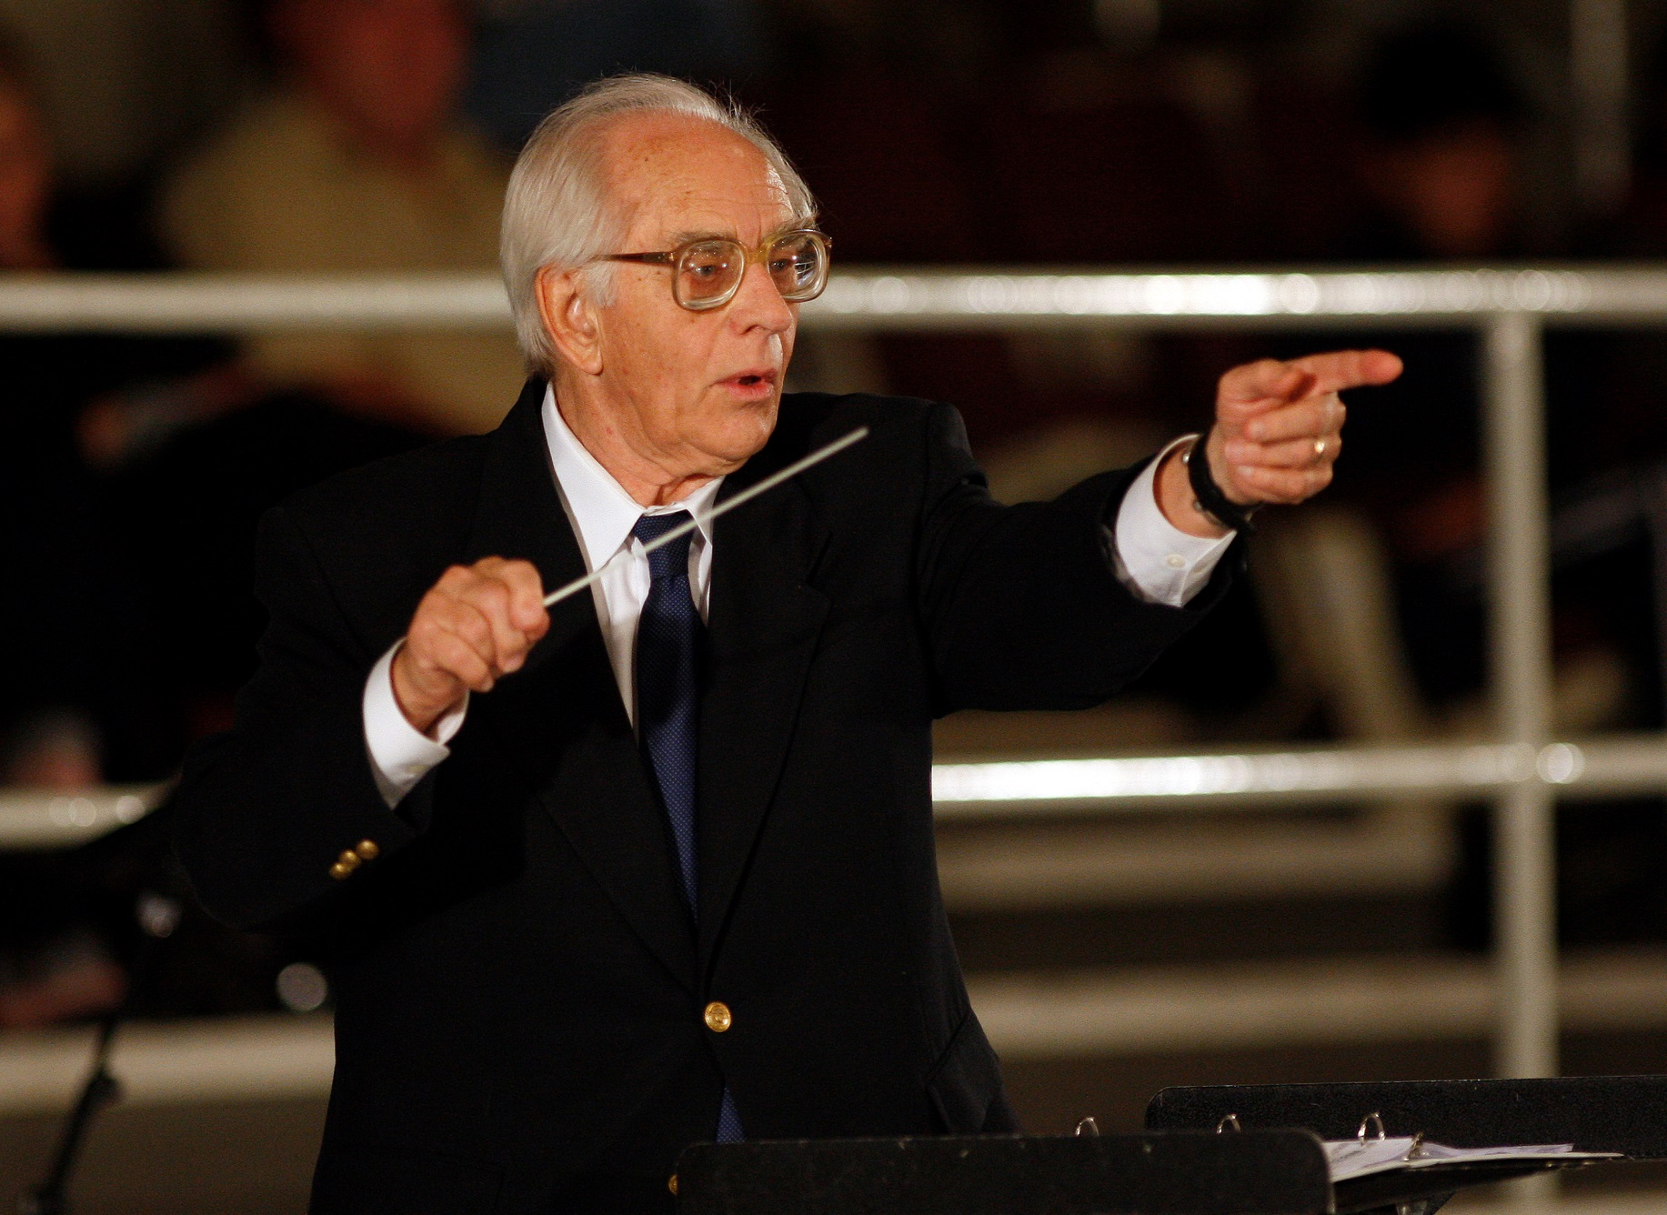

Slide 44
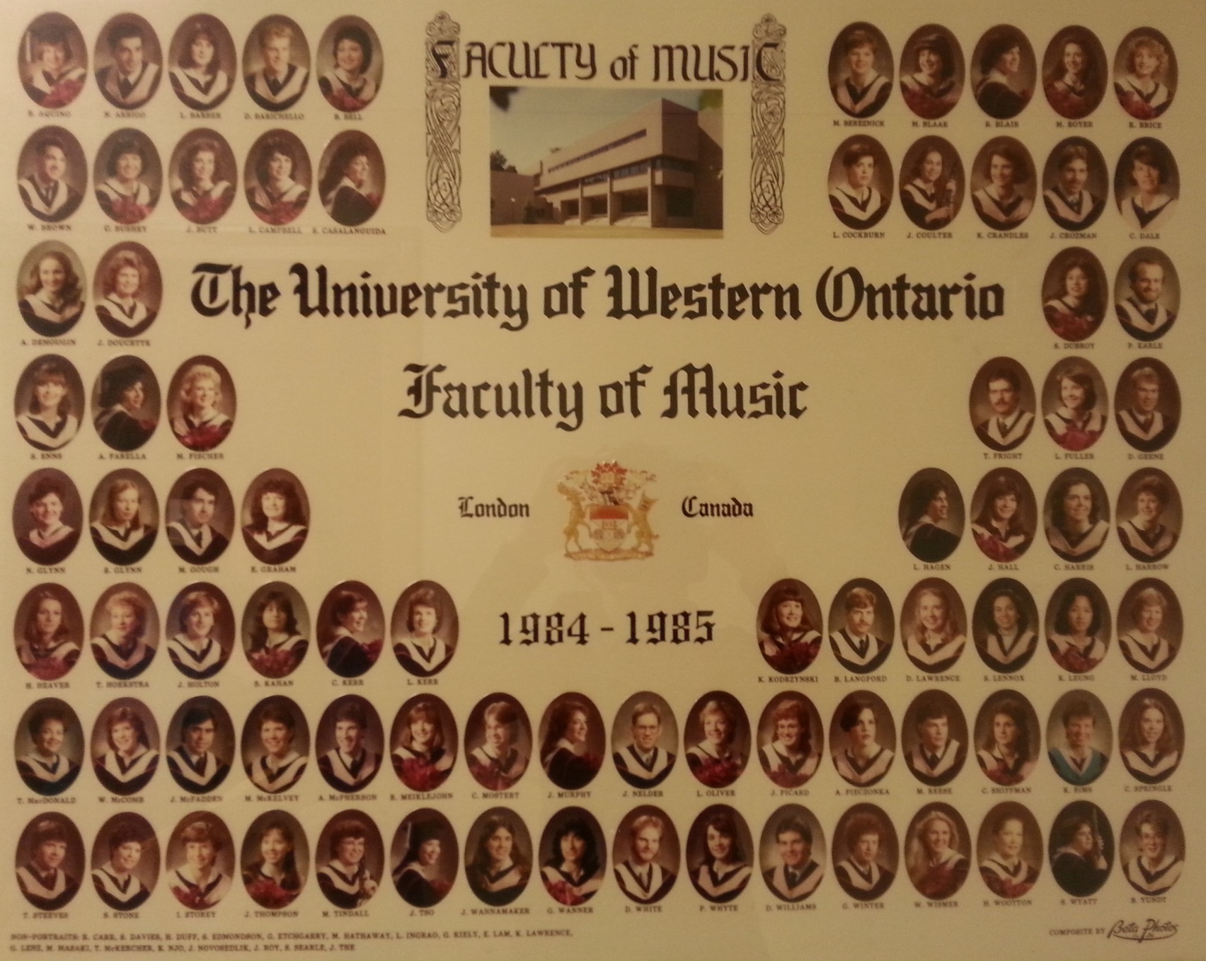

Slide 45
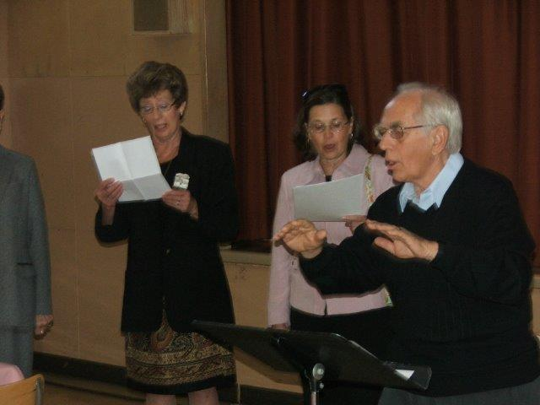

Slide 46
Please pass on that I will be there in spirit. I have very fond memories of Don and my time in his courses when I was there, and when we met up again a one of the reunions. Don will remember me as I was an example he liked to use, to not prejudge ability! I'm sure he will get a chuckle, remembering the story. To Gwyn and Carol and all my friends who are there, best wishes. I am enjoying retirement, and AZ winter. Remember, I have email and would welcome a hello from old friends.
Don, best wishes, and have a happy day.
Charlene Astrom (Hall).

Slide 47
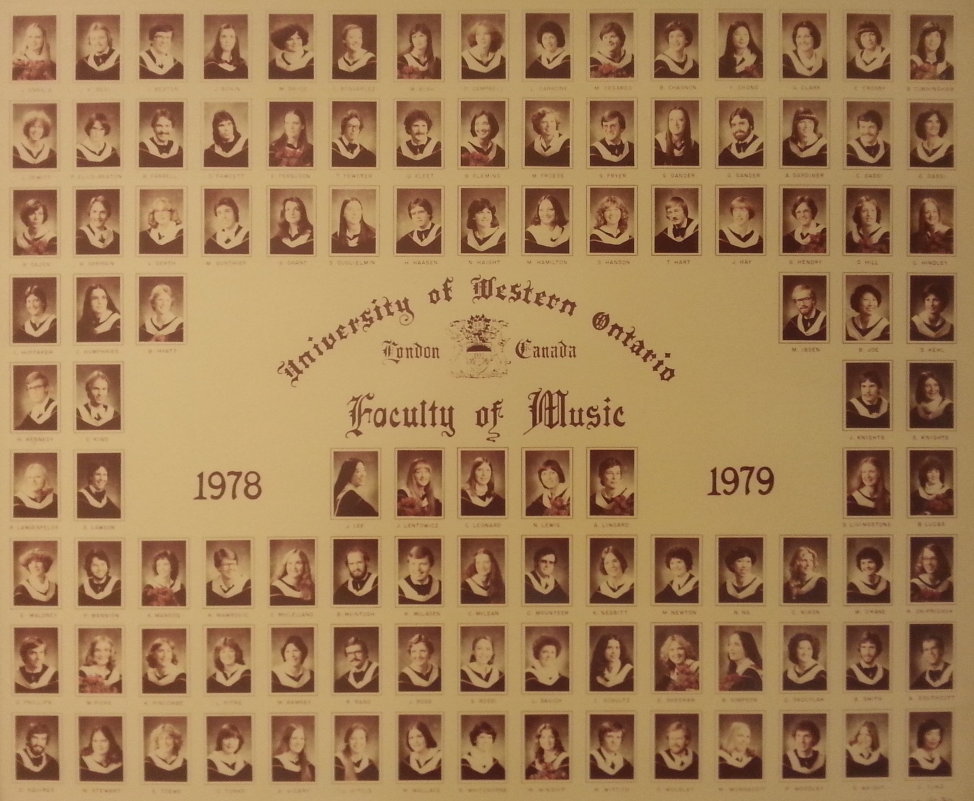

Slide 48
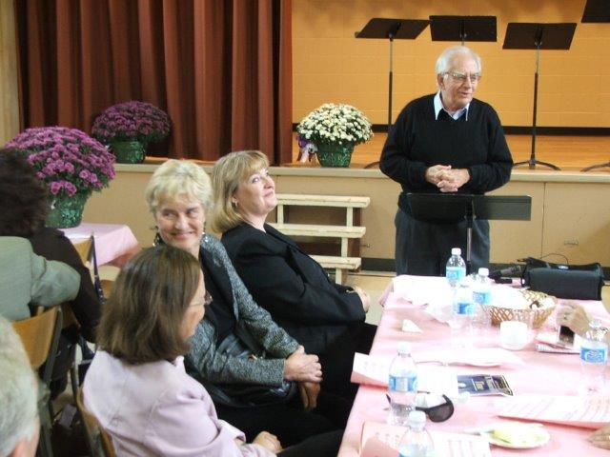

Slide 49
Please extend my congratulations to Professor McKellar. He would know me as the girl trumpet player from Perth Ontario. Professor McKellar was always very special to me and I have many fond memories of him during my years at Western, playing in the Symphonic Band, Wind Ensemble and Orchestra.
All the best in health and happiness in the years ahead.
Sincerely,
Julie Fortner Andrews (BMusArts l982 , BEd, l983)

Slide 50
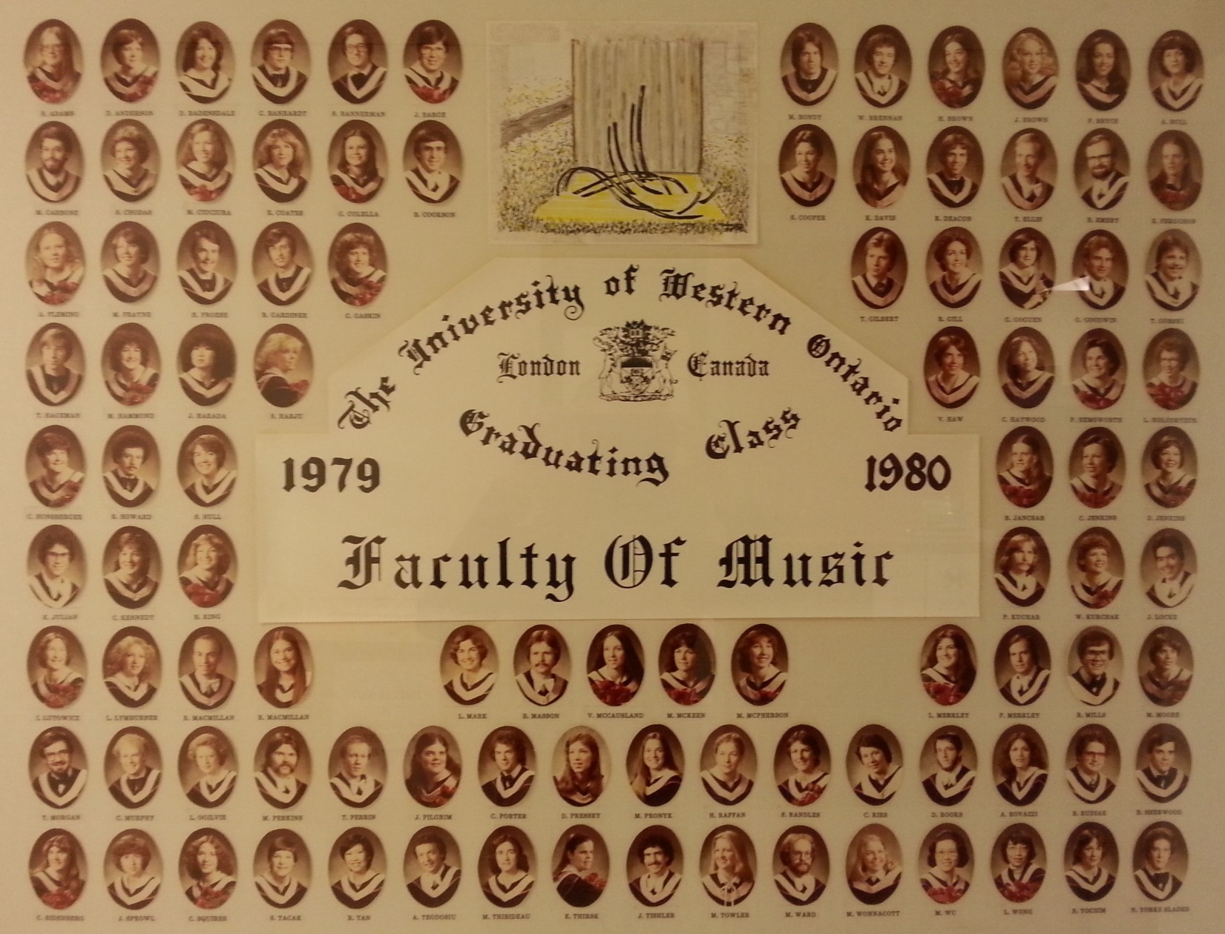

Slide 51
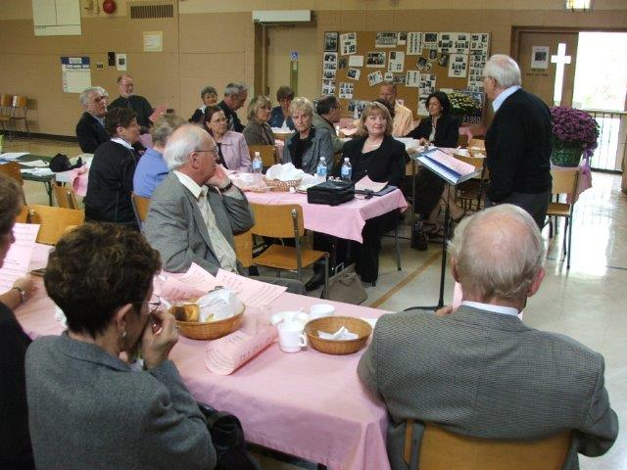

Slide 52
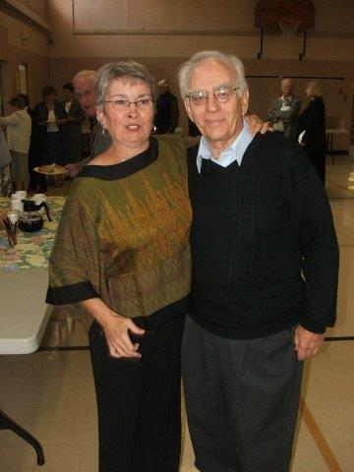

Slide 53
It is unfortunate that I cannot attend because I would have like to join in the celebration of Don. All the best.
Cheers, Helen Connell
Associate Vice-President
Communications & Public Affairs
Western University
Don was very important to the Music School when I went there in 1970. I am grateful for everything he did.
Best wishes,
Frances McBurnie

Slide 54
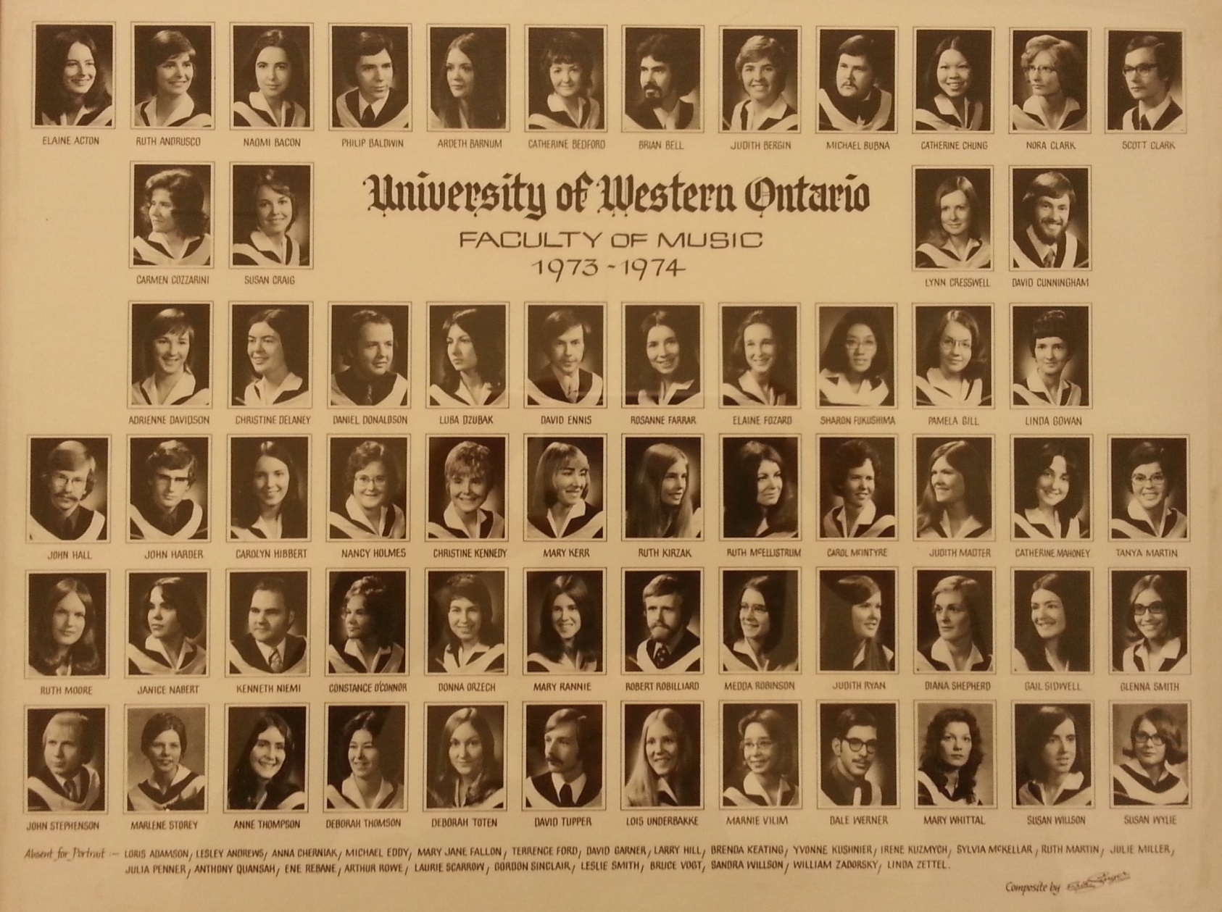

Slide 55
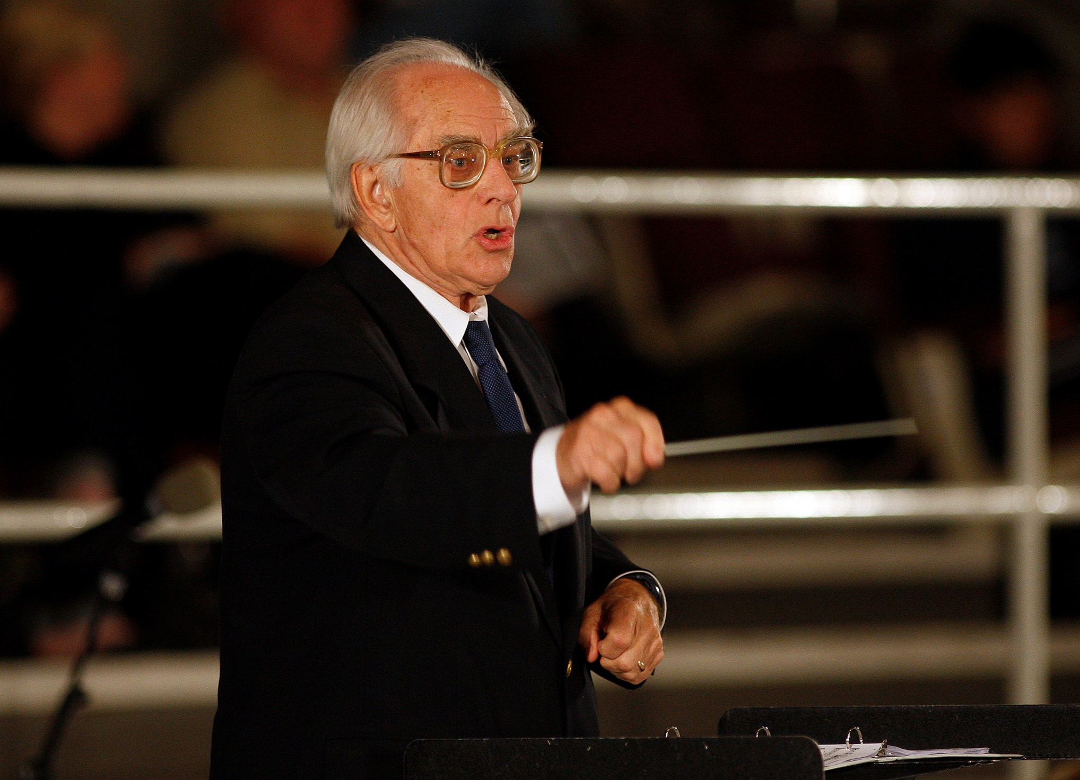

Slide 56
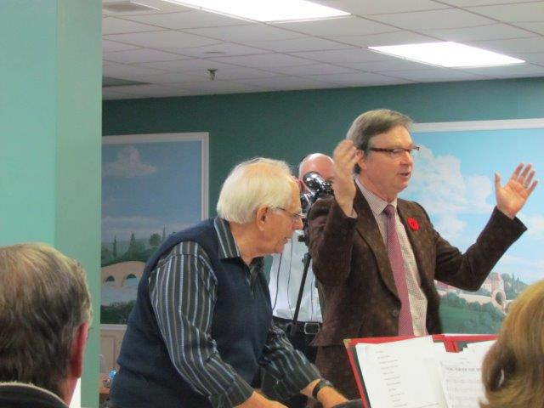

Slide 57
Wonderful that there is a tribute -- sorry but I cannot attend. Hope all goes well.
Best to Don.
Gloria Jean Nagy
Don – all the best! You were instrumental to my career, which I am still doing after 36 years. Thank you.
Tom Pietrangelo
Best wishes Don!
Carol Gibson BMus ‘78

Slide 58
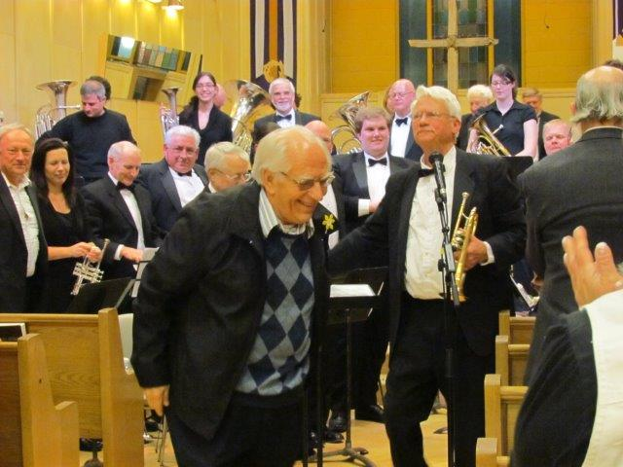

Slide 59
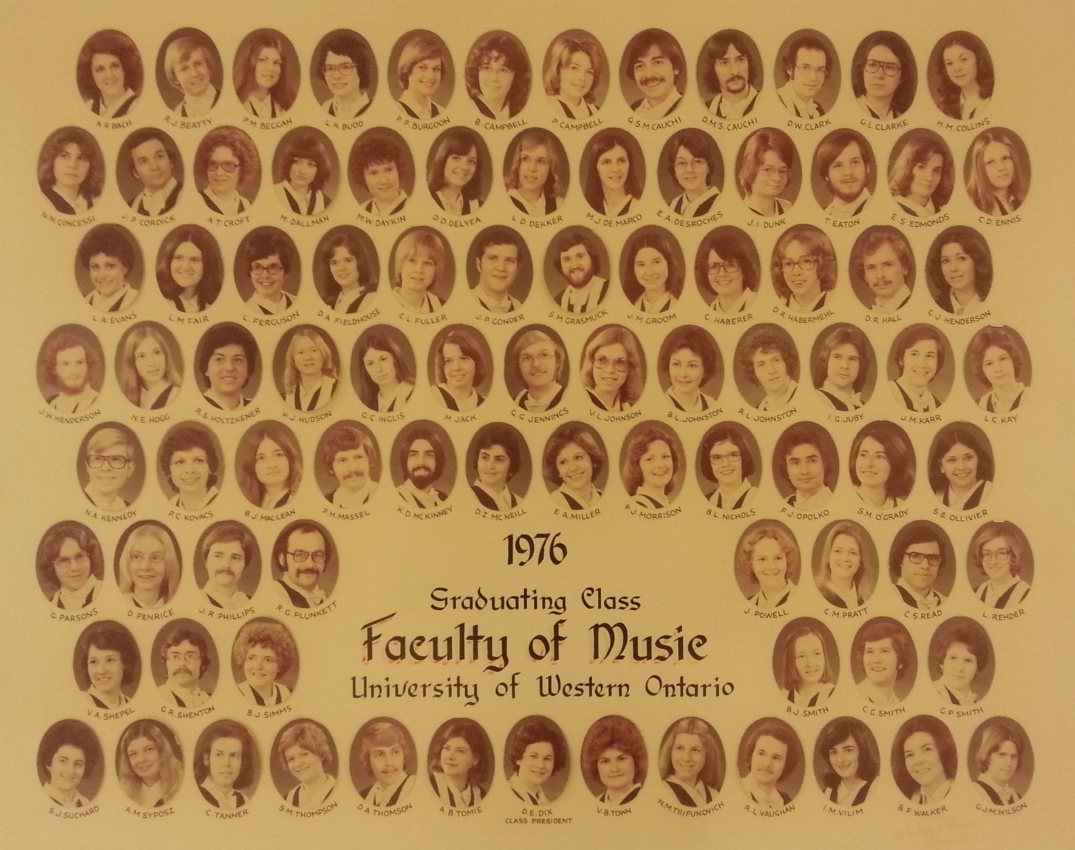

Slide 60
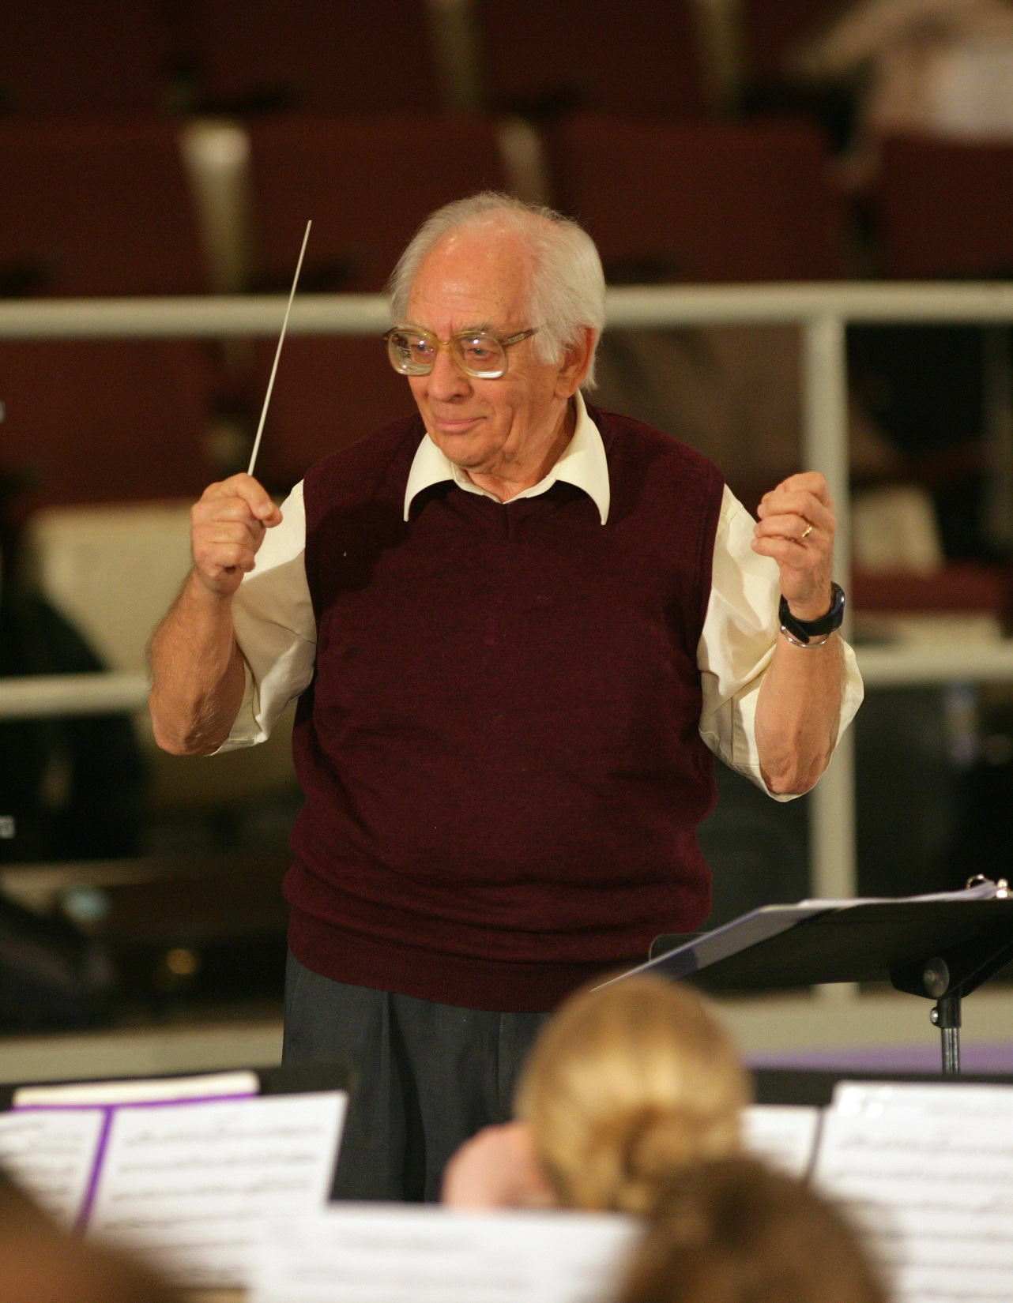

Slide 61
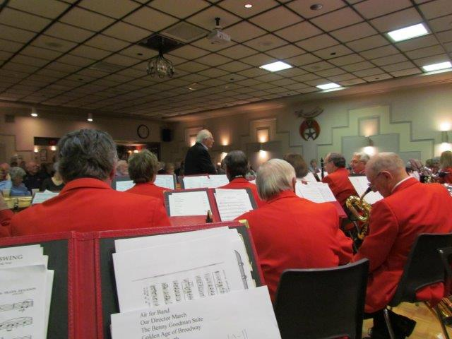

Slide 62
Don was a favourite prof of mine during my Western days, and he was always a loyal jazz fan when he would show up to numerous gigs of mine over the years. Please pass on my regrets. I hope to see him at some other occasion in the near future.
Thanks Darryl Stacey

Slide 63
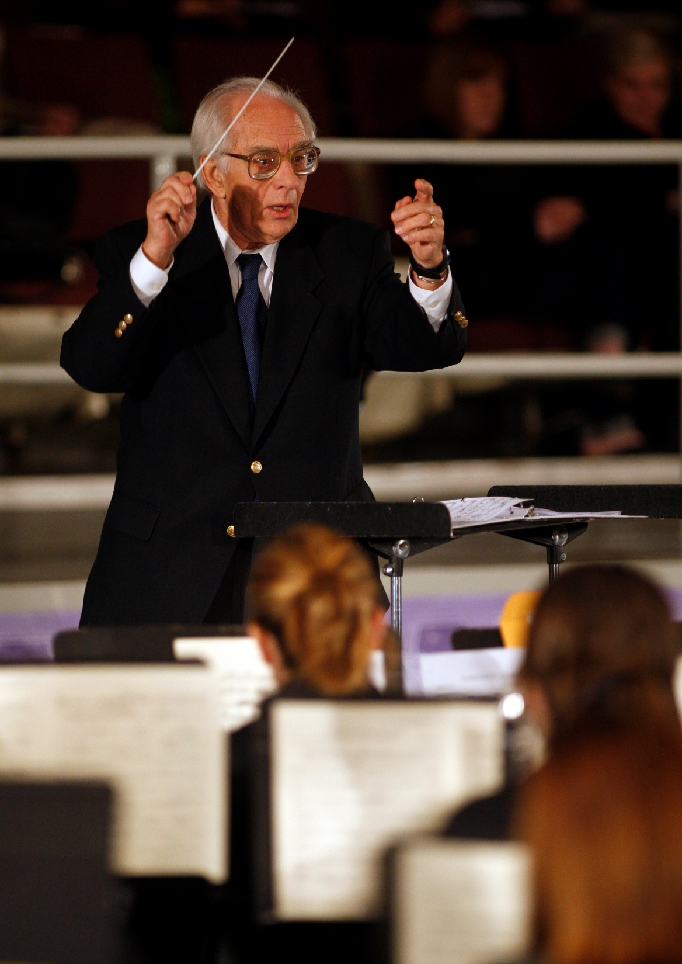

Slide 64
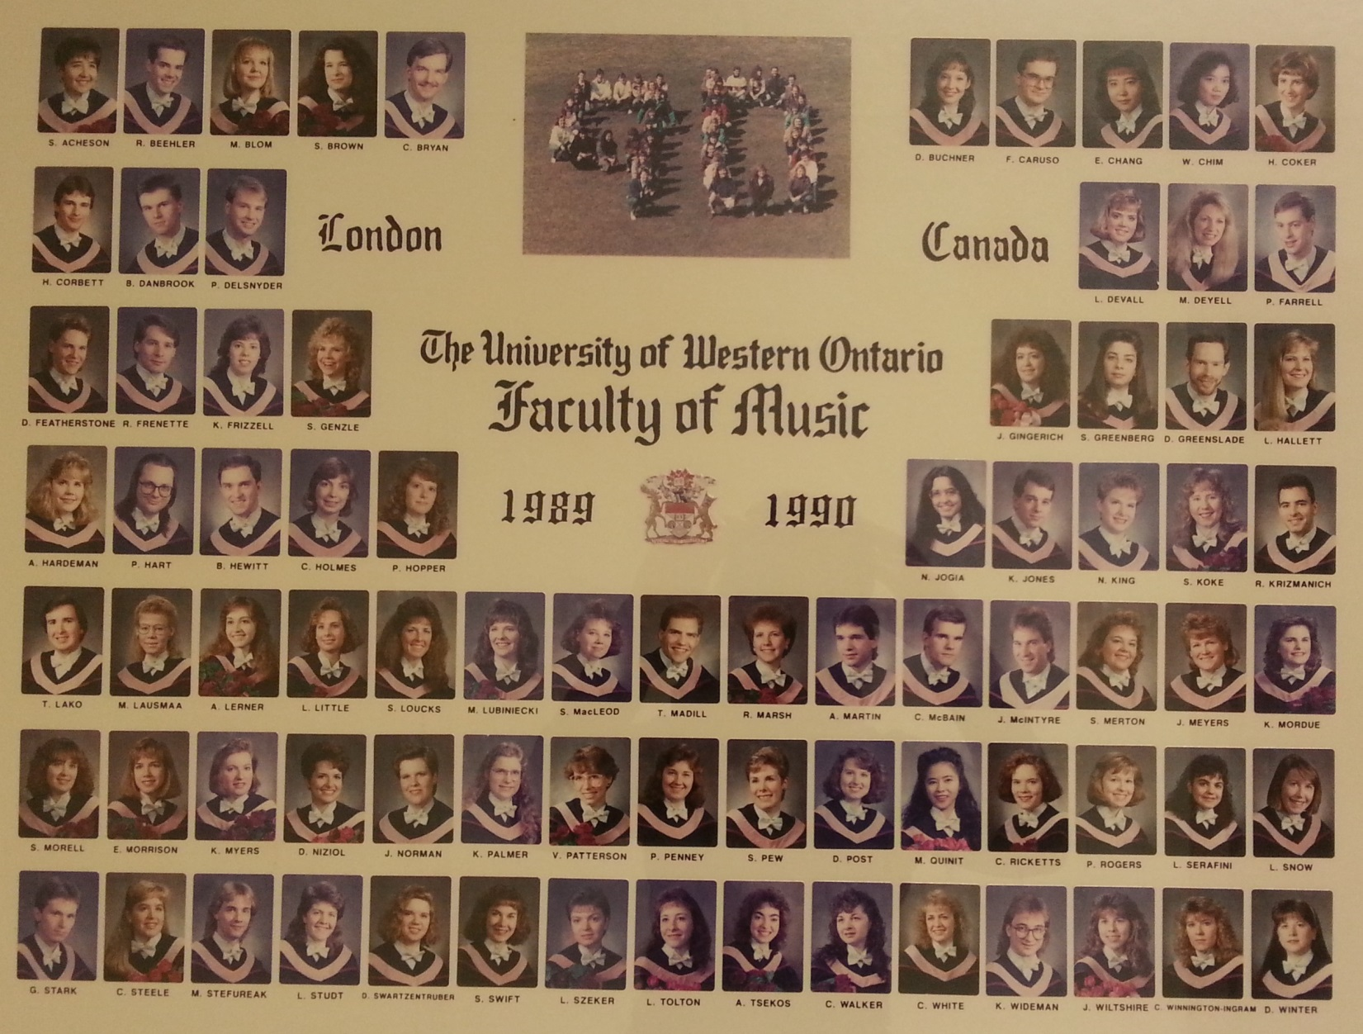

Slide 65
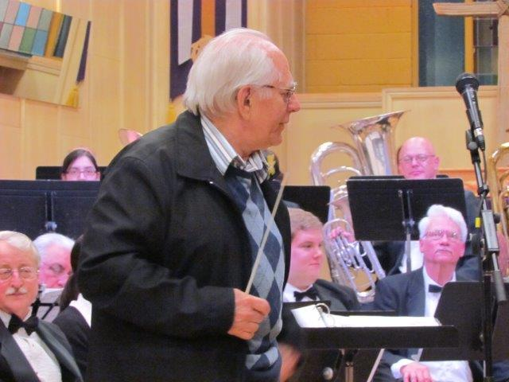

Slide 66
I hope you will let Don know we are thinking of him and about the many times we talked when he was still teaching at Wheable Sec. Sch. and talking to us at the University. We worked quite hard to get him to teach a music ed class at that time and finally after a sort of "revolt" by the students (I was the president of the student council), Music ed was introduced and I was in his first class taught on Saturdays. I have talked with Don numerous times about those days and he is always encouraging me to write something about those turbulent years.
I wish I could be there but will be thinking about Don and all of you, as you celebrate his many contributions.
Donald Jones

Slide 67


Slide 68
I never studied under Don, but my father (William J Rudiak) was a graduate of Western’s (still then) College of Music in 1966 and did work with Professor McKellar. I met Don several times when I was at Western in 1976-1981 and he did remember my father, who went on to be the Music Department Head at Elliot Lake Secondary School in Elliot Lake, Ontario before dying very young in 1977 at age 44. I hope you have a good event, and please pass on wishes from my father Bill and Bill Jr.
Thank you.
Best regards,
Bill Rudiak, BMus 1980, Theory & Composition

Slide 69


